Slide 1
TEAS Math Workshop
Part 2: Algebra

Slide 2
Some introductory notes
The introductory slides are the same for all parts of the workshop.
This workshop is designed to be a comprehensive review of basic math skills and topics that may appear on the TEAS test.
There may be some topics in here that are not covered on the TEAS, and there may be some topics that appear on the TEAS that I did not cover in this workshop. I have never taken the TEAS, but I took some online practice tests and consulted a TEAS prep book for practice and inspiration.
I did my best. If you find any inaccuracies in or have any questions about the workshop, please feel free to email me at jcarter@goodwin.edu.

Slide 3
Some introductory notes
The introductory slides are the same for all parts of the workshop.
In 2020, a colleague and I recorded videos that accompanied this workshop, but they were recorded before the University switched to Canvas. After that switch, the videos were lost.
I have inserted links to videos, websites, and PDFs with practice problems in many of the following slides to make up for the missing videos. The citations for all of these resources are located at the end of this slideshow.
Note:
I am in no way affiliated with the YouTubers or any websites I link in the slideshow. I chose these creators because I like the way they explain math concepts, and I chose the websites because they have a lot of examples (and most have answer keys so you can check your answers).

Slide 4
Some introductory notes
The introductory slides are the same for all parts of the workshop.
If you prefer to work with a tutor or if you want to review a math topic in more depth after completing the workshop, feel free to schedule an appointment with a math tutor! Please come prepared to the appointment with examples to review.
There are also English and science tutors available if you would like to review those subjects. You do not need to be currently enrolled in a math, English, or science course to sign up for TEAS tutoring; you just need to be a current Goodwin student.
Appointments can be on-ground or virtual, but please ensure you read each tutor’s availability carefully so you know if they are on-ground or virtual.

Slide 5
Some introductory notes
The introductory slides are the same for all parts of the workshop.
I know that was a ton of information, and I’m sorry. I just want you to feel as prepared as possible. Some of the videos I linked are pretty long; please don’t feel obligated to watch the whole thing if you don’t need to! I hope you find this workshop helpful.
There is a lot of math to review in here. Remember to take breaks! (I remind you of that a few times throughout the slideshows.)
Now let’s get to the math!
Jenna Carter, Professional Math Tutor

Slide 6

How I’m sure many of you feel
The introductory slides are the same for all parts of the workshop.
But please remember: your mindset can have a HUGE effect on your performance.
Think positively!
For example, instead of thinking, “This is too hard!” think, “With more practice, I will improve!”
[jason701802]. (2010, Aug 19). I'm afraid we need to use...MATH [Video]. YouTube. https://www.youtube.com/watch?v=gENVB6tjq_M

Slide 7
Algebra
Table of Contents
Algebraic Expressions
Operations with Expressions
Linear Equations
Inequalities
Problem Solving Strategies
In this part of the workshop, we will review equations and expressions with variables. (This is a short slideshow compared to the other parts.)
Any text in this slideshow in the pink color shown in the box to the right are links to other slides in this presentation.

Slide 8
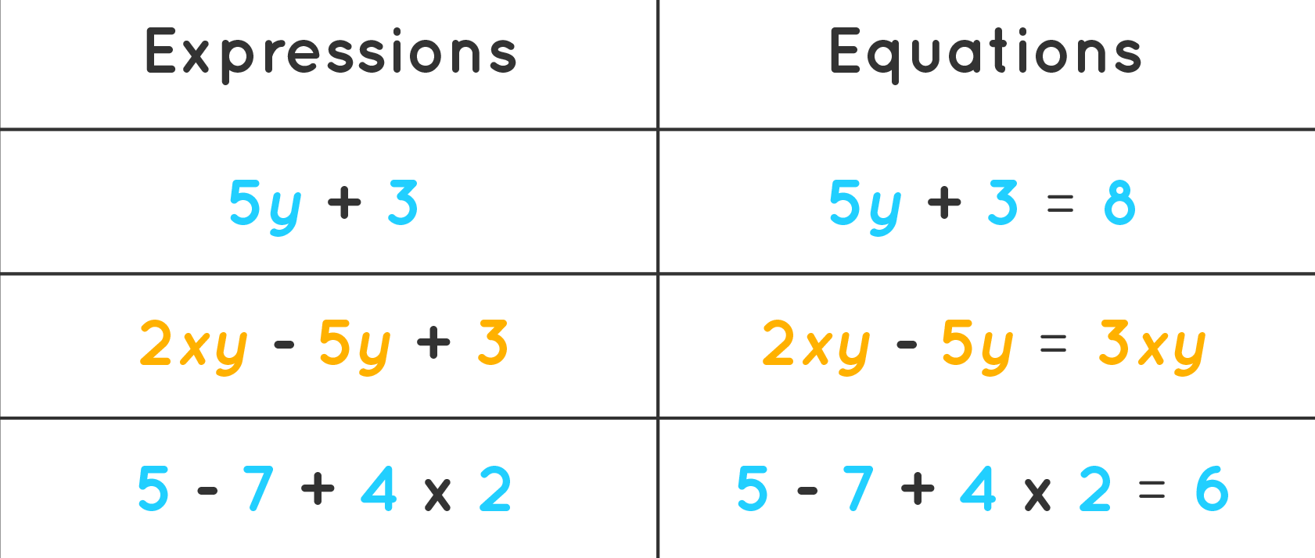
Algebraic Expressions¹
Any text in that reddish color will take you to videos, sites, or PDFs that will help you as you review!
Expression: a mathematical statement without an equal sign
Numerical expression: any sum, difference, product, or quotient of constants only
Algebraic expression: any sum, difference, product, or quotient of variables and constants
Equation: a mathematical statement that two expressions are equal
Figure 1. Expressions vs. equations. Adapted from Expressions in math, retrieved from https://www.cuemath.com/algebra/expression-definition/.
Anything in this small writing is a citation for a picture. You can click the links, but they may just be the web address of the picture in the slide.

Slide 9
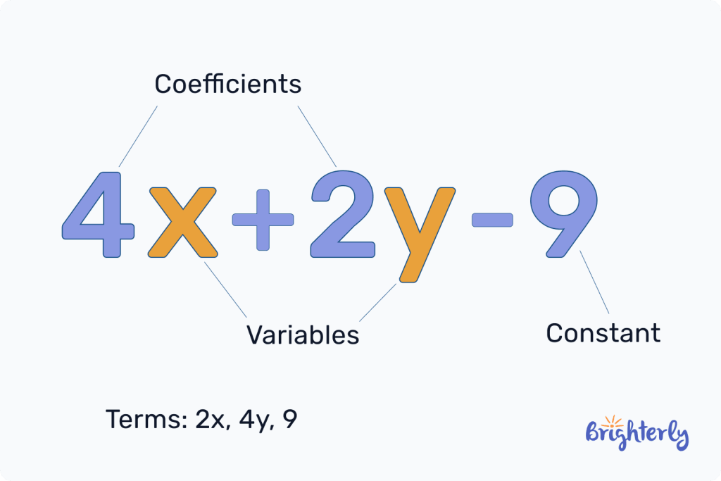
Algebraic Expressions: Vocabulary (Slide 1 of 2)
Constant: a fixed value
Examples: -4, 0.7, ½, π
Variable: an unknown number represented by a symbol (commonly x)
Coefficient: a number multiplied by a variable
Term: a quantity that is added or subtracted
Like terms: terms that contain the same variable raised to the same exponent
Figure 2. Parts of expressions. Adapted from Expression in Math (Definition with Examples) by Camille Ira B. Mendoza, 2024, retrieved from https://brighterly.com/math/expression/. Copyright 2025 by Brighterly.

Slide 10
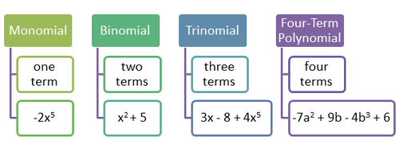
Algebraic Expressions: Vocabulary (Slide 2 of 2)
Monomial: an algebraic expression with one term where all the exponents on the variables are whole numbers
Polynomial: an algebraic expression with more than one term where all the exponents on the variables are whole numbers
Binomial: a polynomial with 2 terms
Trinomial: a polynomial with 3 terms
Figure 3. Monomial through polynomial. Adapted from 12.1 Recognize and Identify Monomials, Binomials and Trinomials by Brenda Meery and Jen Kershaw, 2025, retrieved from https://flexbooks.ck12.org/cbook/ck-12-conceptos-de-matem%C3%A1ticas-de-la-escuela-secundaria-grado-8-en-espa%C3%B1ol/section/12.1/related/lesson/recognize-and-identify-monomials-binomials-and-trinomials-msm8/. Copyright 2025 by CK-12 Foundation.

Slide 11
Algebraic Expressions: Simplifying
To simplify expressions, you will use two skills: combining like terms and distribution.
Combining like terms²: collecting all similar terms together in an expression
Like terms are terms that have the same variable raised to the same power.
Be careful with positives and negatives when combining like terms!
Note:
Although the terms 5x and -3xz both contain an x, they are NOT like terms because of the z in the second term.

Slide 12
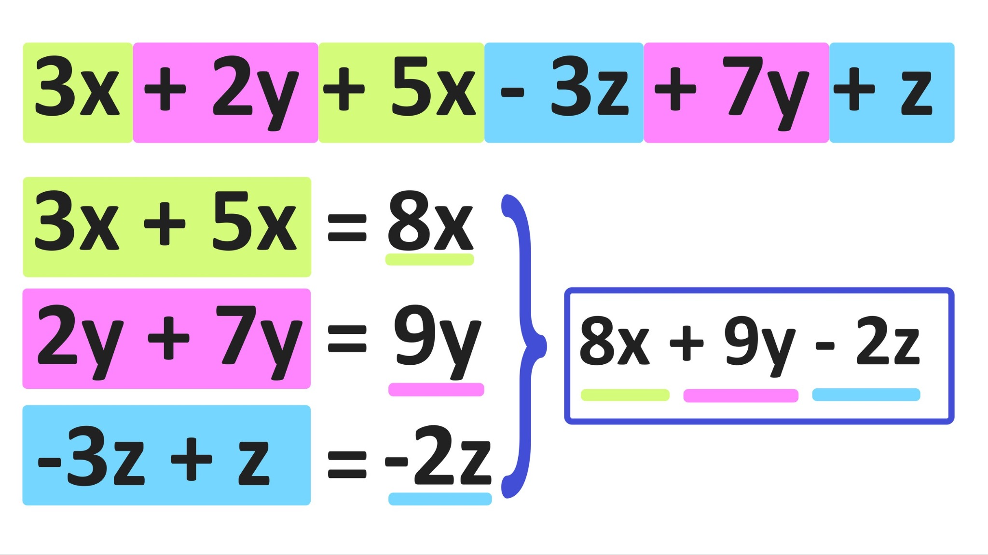
Algebraic Expressions: Simplifying
Look for the orange star in the top right corner to quickly identify slides that have links to practice worksheets.
In the picture to the left, notice that the sign before the term goes with that term.
Practice³ for combining like terms.
Figure 4. Combining like terms. Adapted from Combining Like Terms Explained - Examples, Worksheet Included, 2023, retrieved from https://www.mashupmath.com/blog/combining-like-terms. Copyright 2025 by Mashup Math LLC.

Slide 13
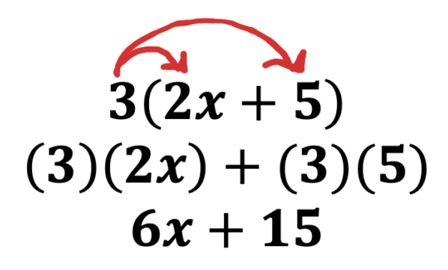
Algebraic Expressions: Simplifying
Distribution⁴: a method of simplifying an expression by multiplying it by a constant or another expression
The goal of distribution is to get rid of parentheses.
Practice⁵ for distribution.
Figure 5. Distributive property. Adapted from Distribution Practice, retrieved from https://andymath.com/distribution-practice/. Copyright 2025 by Astra WordPress Theme.
Note:
When you distribute a negative over a set of parentheses, every sign inside the parentheses changes!

Slide 14
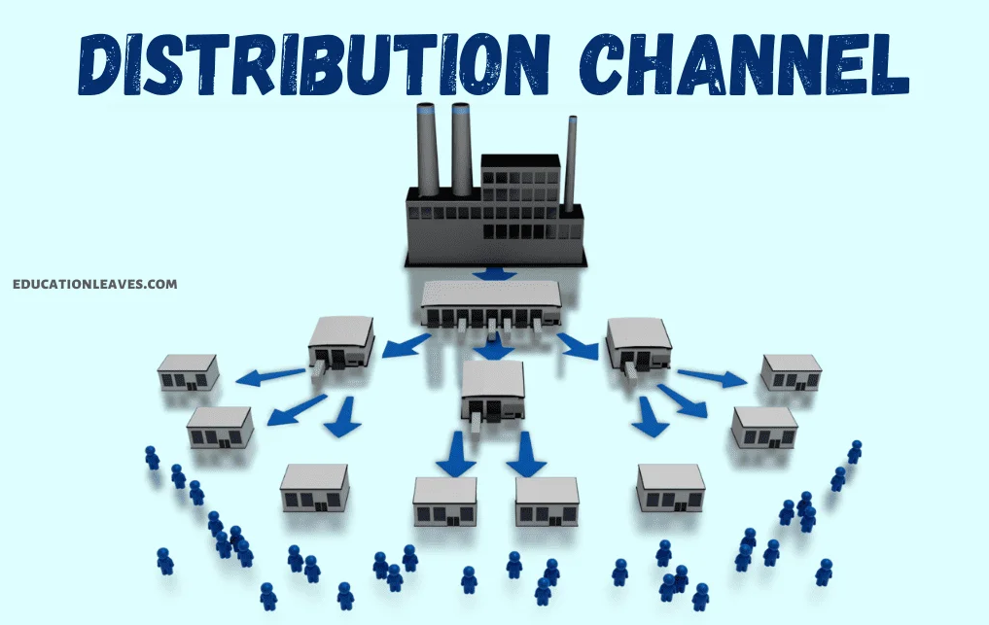
Algebraic Expressions: Simplifying
☆ Pro Tip ☆
Think of what the word distribution (or distribute) means outside of math.
When you distribute a worksheet, you pass it out and make sure that everyone gets one!
A distribution center sends out products to different locations!
Figure 6. Distribution channel. Adapted from Distribution Channel or Channel of Distribution [PDF Included] Definition, Types, Functions, Benefits, and Drawbacks by Sushanta Maiti, 2022, retrieved from https://educationleaves.com/distribution-channel/. Copyright 2025 by EducationLeaves.

Slide 15
Algebraic Expressions: Simplifying
Simplifying algebraic expressions⁶ is the process of transforming expressions so that all like terms are together and there are no parentheses.
A simplified expression may still contain one or more variables, like the example to the right.
Practice⁷ for simplifying algebraic expressions.
Note:
Simplified algebraic expressions are ordered by variable terms alphabetically and progressing from the highest exponent down to constants.
x⁴ − 2x³ + 5x² + 9y² − 7y + 3

Slide 16
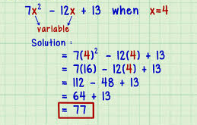
Algebraic Expressions: Evaluating
Evaluating an algebraic expression⁸ is the process of substituting a given value into an expression in place of the variable and then simplifying.
When you substitute a value in place of a variable, you get rid of the variable, just like making a substitution in sports!
Practice⁹ for evaluating algebraic expressions.
Figure 7. Evaluate the expression. Adapted from How to Evaluate an Algebraic Expression by Taylor Klein, 2024, retrieved from https://www.wikihow.com/Evaluate-an-Algebraic-Expression.

Slide 17
Algebraic Expressions: Reminder
This is the end of the algebraic expressions part. If you still feel like you want to practice more, search for more videos and worksheets!
If you’d like to return to the Table of Contents slide, click here.

Slide 18
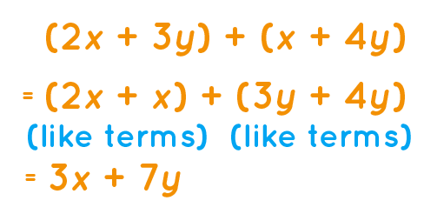
Operations with Expressions: Addition
Expressions can be added and subtracted¹⁰ by distributing and combining like terms.
In the example to the right, since you are adding the expressions, you can simply drop the parentheses and combine like terms.
There is an example of subtracting algebraic expressions on the next slide.
Figure 8. Adding expressions. Adapted from Addition of Algebraic Expressions, retrieved from https://www.cuemath.com/algebra/addition-of-algebraic-expressions/.

Slide 19
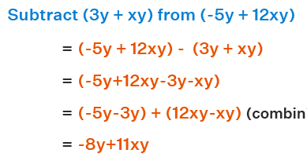
Operations with Expressions: Subtraction
In the example to the below, since you are subtracting the expressions, you have to distribute the negative to each term inside the second set of parentheses.
Practice¹¹ for adding and subtracting algebraic expressions.
Figure 9. Subtracting expressions. Adapted from Subtraction of Algebraic Expressions, retrieved from https://www.cuemath.com/algebra/subtraction-of-algebraic-expressions/.

Slide 20
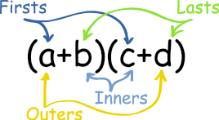
Operations with Expressions: Distribution
In terms of multiplication with expressions, we call it distribution, which we have already done with a monomial. What happens if we multiply polynomials together?
You may have learned the FOIL method (first, outer, inner, last) for multiplying two binomials, but take a look at the next slide.
Using FOIL in the image below, you get ac + ad + bc + bd.
Figure 10. Firsts Outers Inners Lasts. Adapted from Definition of FOIL Method, retrieved from https://www.mathsisfun.com/definitions/foil-method.html. Copyright 2025 by Rod Pierce.

Slide 21
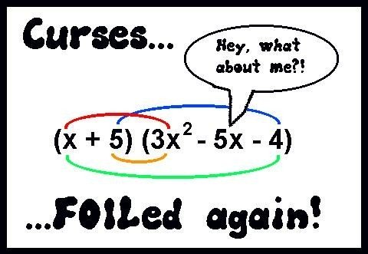
Operations with Expressions: Distribution
FOIL is a helpful mnemonic device, but it only applies if you’re multiplying two binomials. What if you’re multiplying a binomial by a trinomial (as shown in the image), or a trinomial by a trinomial?
We distribute¹² so that we don’t miss multiplying any terms.
Practice¹³ for distributing polynomials.
Figure 11. Curses FOILed again. Adapted from Curses... FOILed Again, 2016, retrieved from https://patch.com/new-jersey/fortlee/curses-foiled-again. Copyright 2025 by Patch Media.

Slide 22
Operations with Expressions: Factoring¹⁴
Factoring: the process of changing a polynomial in standard form into a product of two or more factors
It is the opposite (or the inverse) of distribution.
Factoring is another application of finding the greatest common factor (GCF), which we reviewed in Part 1 of the workshop.
Example: In the binomial x² + 3x, both of the terms have an x. Therefore, you can factor out an x to rewrite the expression as x(x + 3). To check your answer, distribute and see if you get what you started with.
Practice¹⁵ for factoring polynomials.

Slide 23
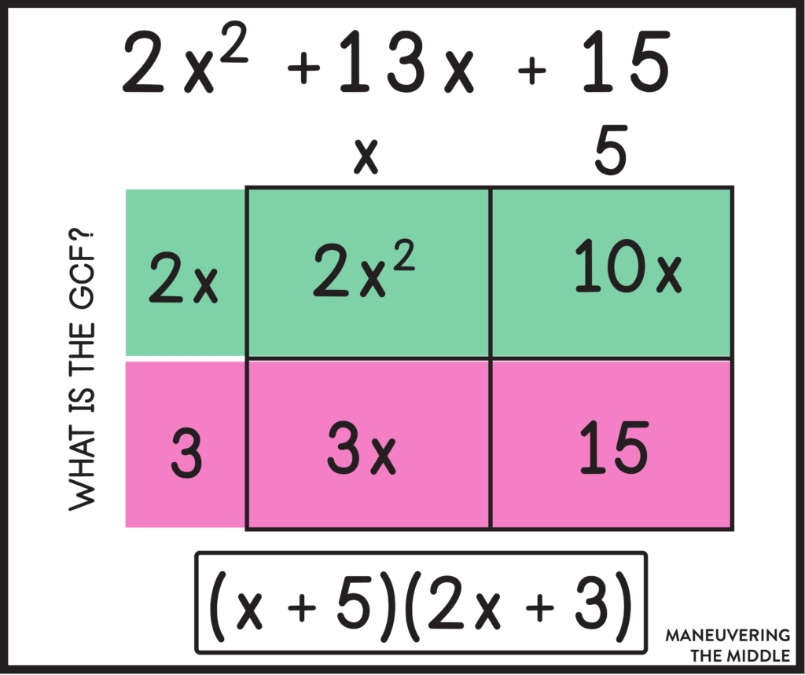
Operations with Expressions: Factoring
I don’t think you will need to factor a trinomial¹⁶ into two binomials, but you can watch the video to be safe.
☆ Pro Tip ☆
Think of what the word factor means in math. Factors are numbers that are multiplied. When factoring a polynomial, we are finding two (or more) expressions that are multiplied to get that polynomial.
Figure 12. Factoring a trinomial. Adapted from Factoring Polynomials with Special Cases, retrieved from https://www.maneuveringthemiddle.com/factoring-polynomials-with-special-cases/. Copyright 2025 by Maneuvering the Middle.

Slide 24
Operations with Expressions: Reminder
I hope you’re finding these workshops helpful. If you have any questions, concerns, or comments, please feel free to email me!
If you’d like to return to the Table of Contents slide, click here.

Slide 25
Linear Equations
Linear equation: an equation in which the highest power of any exponent on a variable is 1
When a variable has no exponent shown, the exponent is 1.
When graphed, a linear equation makes a line (we will review graphing later in this slideshow).
Note:
The difference between equations and expressions is that equations have equal signs while expressions do not.
Expression: x + 4
Equation: x + 4 = 0
Also we evaluate expressions, but we solve equations!

Slide 26
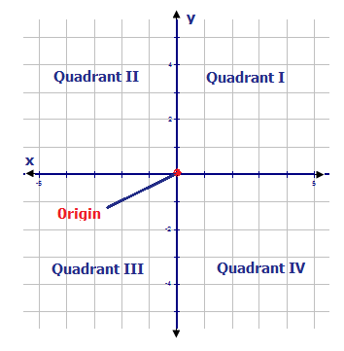
Linear Equations: Vocabulary (Slide 1 of 2)
Coordinate plane: a two-dimensional surface formed by two perpendicular number lines (the x-axis and the y-axis)
Ordered pair: a set of two coordinates (x, y)
that give a location in the coordinate plane
Origin: the point where the x- and y-axes intersect
The coordinates for the origin are (0, 0).
Figure 13. Cartesian coordinate system. Adapted from 2.14 The Cartesian Plane by Brenda Meery and Kaitlyn Spong, 2025, retrieved from https://flexbooks.ck12.org/cbook/ck-12-conceptos-de-matem%C3%A1ticas-de-la-escuela-secundaria-grado-6-en-espa%C3%B1ol/section/2.14/related/lesson/the-cartesian-plane-alg-i-hnrs/. Copyright 2025 by CK-12 Foundation.

Slide 27
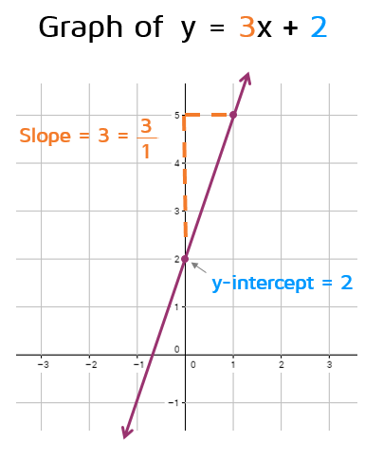
Linear Equations: Vocabulary (Slide 2 of 2)
Slope (or rate of change): the steepness and direction of a line
We use m to represent slope.
Intercept: a point where the graph of a line
intersects an axis
x-intercept: the point where a graph
intersects the x-axis
y-intercept (or initial value): the point
where a graph intersects the y-axis
We use b to represent the
y-intercept.
Figure 14. Graph of y=3x+2. Adapted from Intro to Slope-Intercept Form, retrieved from https://www.katesmathlessons.com/intro-to-slope-intercept-form.html. Copyright 2021 by Kate’s Math Lessons.

Slide 28
Linear Equations: Solving
When solving a linear equation, the goal is to get one variable by itself. We call this “isolating a variable.”
To isolate a variable, you are going to “undo” the order of operations. That is, you are going to do it backwards and use inverse operations.
The videos are on the next slide!
☆ Pro Tip ☆
Think of isolating a variable like driving home from a friend’s house. If you take 3 right turns, 2 left turns, and 4 right turns to get to their house, then you take 4 left turns, 2 right turns, and 3 left turns to get home!

Slide 29
Linear Equations: Solving
Important concepts in solving equations:
Using inverse operations (or opposite operations)
Using the order of operations in reverse
Whatever we do to one side of the equation, we must do to the other
A teacher I know calls this “The Golden Rule of Algebra.”
When we solve equations, we say that there are one-step equations¹⁷, two-step equations¹⁸, and multi-step equations¹⁹.
(The steps I use to solve equations are on the next slide.)
Practice for solving one-step equations²⁰, two-step equations²¹, and multi-step equations²².

Slide 30
Linear Equations: Solving
Steps for Solving Multi-Step Equations: (You will not have to perform all of these steps every time you solve an equation!)
Eliminate fractions by multiplying each side of the equation by the LCM of all denominators.
Distribute to eliminate parentheses and brackets.
Combine like terms.
“Undo” the Order of Operations (i.e., do it in reverse).
Use additive inverses (opposites) to collect all terms containing the variable of interest to one side, and all terms not containing the variable to the other side.
Use multiplicative inverses (reciprocals) to remove coefficients from the variable being solved for.

Slide 31
Linear Equations: Slope²³
rise
run
Slope is commonly referred to as “rise over run.” Another phrase for slope is “rate of change.”
If the slope is positive, the line will point up and to the right ↗️ (or down and to the left ↙️).
If the slope is negative, the line will point down and to the right ↘️ (or up and to the left ↖️).
If the slope is 0, the line is horizontal. ↔️
The equation of a horizontal line will have no x in it (y = 6, y = -¼, etc.).
If the slope is undefined, the line is vertical. ↕️
The equation of a vertical line will have no y in it (x = 12, x = -2.3, etc.).

Slide 32
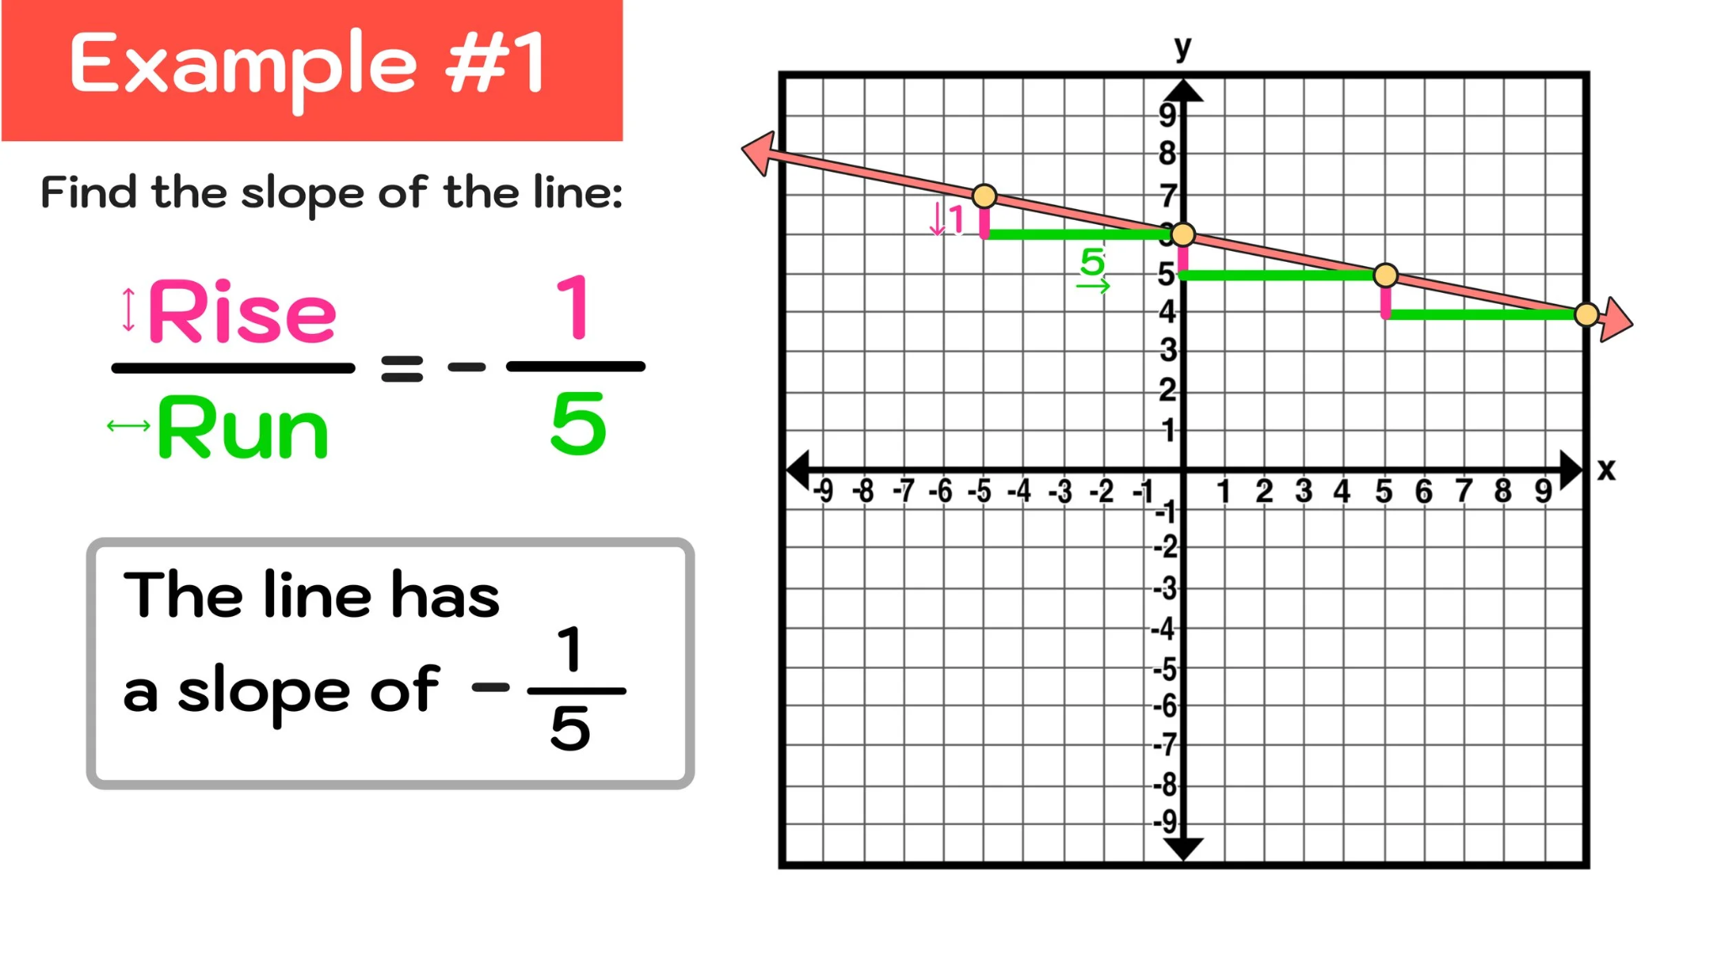
Linear Equations: Finding Slope
There are a couple of ways to find the slope of a line.
If you are asked to find the slope of a line from a graph²⁴, you can count the number of spaces moved up (or down) and put it over the number of spaces moved right (or left).
Figure 15. Slope example #1. Adapted from How to Find Slope on a Graph in 3 Easy Steps, 2024, retrieved from https://www.mashupmath.com/blog/how-to-find-slope-on-a-graph#google_vignette. Copyright 2025 by Mashup Math LLC.

Slide 33
Linear Equations: Finding Slope
For the graph to the right, the slope is negative because the line is going down and to the right. If it were going up and to the right, the slope would be positive.
Practice²⁵ for finding slope from a graph.
Figure 15. Slope example #1. Adapted from How to Find Slope on a Graph in 3 Easy Steps, 2024, retrieved from https://www.mashupmath.com/blog/how-to-find-slope-on-a-graph#google_vignette. Copyright 2025 by Mashup Math LLC.

Slide 34
Linear Equations: Finding Slope
There are a couple of ways to find the slope of a line.
If you are asked to find the slope of a line from two ordered pairs²⁶, you can calculate the slope of the line that contains those ordered pairs.
Given the ordered pairs (x₁, y₁), (x₂, y₂), the slope of the line that contains those ordered pairs is:
y₂ − y₁
x₂ − x₁
Note:
In an ordered pair, x always comes before y, just like in the alphabet!
In the ordered pair (3, -2), 3 is the x-coordinate, and -2 is the y-coordinate.
m =

Slide 35
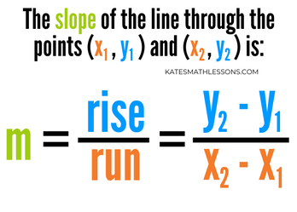
Linear Equations: Finding Slope
Practice²⁷ for calculating slope using the slope formula.
☆ Pro Tip ☆
When using the slope formula, it doesn’t matter which ordered pair you assign as 1 and which one you assign as 2. Just make sure that whichever y-value you use first, you use the x-value from the same ordered pair first.
Figure 16. The slope formula. Adapted from Using Points To Write Equation In Slope-Intercept Form, retrieved from https://www.katesmathlessons.com/using-points-to-write-equation-in-slope-intercept-form.html. Copyright 2021 by Kate’s Math Lessons.

Slide 36
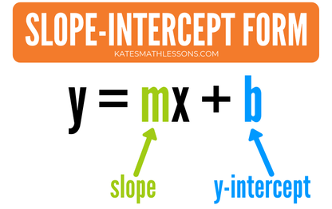
Linear Equations: Slope-Intercept Form
The most common form of linear equations is slope-intercept form²⁸.
This form is so named because you can easily identify the slope and the y-intercept in this form.
Slope-intercept form is usually the easiest form of a linear equation to use for graphing!
Figure 17. Slope-intercept form. Adapted from Using Points To Write Equation In Slope-Intercept Form, retrieved from https://www.katesmathlessons.com/using-points-to-write-equation-in-slope-intercept-form.html. Copyright 2021 by Kate’s Math Lessons.

Slide 37
Linear Equations: Graphing²⁹
To graph a linear equation in slope-intercept form (y = mx + b):
Identify and graph the y-intercept (0, b).
Use the slope (m) to find another point on the line.
If the slope is a whole number, make it a fraction by putting 1 underneath it (in the denominator).
Then remember: rise over run. Go up (for positive) or down (for negative) the number of places in the numerator, then go to the right the number of places in the denominator.
Connect those 2 points! You only need 2 points to determine a line, so you’re done.

Slide 38
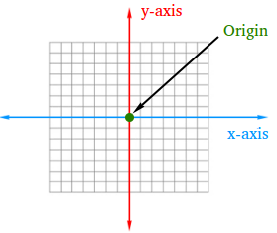
Linear Equations: Graphing
Practice³⁰ for graphing linear equations.
Note:
Think “begin, move” to remember that b is the y-intercept (where to begin) and m is the slope (how the line moves).
Always start plotting your graph at the origin, where the x- and y-axes intersect.
Figure 18. Origin on a graph. Adapted from What is the origin in math? Definition and illustration, retrieved from https://www.math-dictionary.com/origin.html#google_vignette. Copyright 2018 by Math-dictionary.com.

Slide 39
Linear Equations: Reminder
I know that was a lot! Remember to take breaks when studying.
If you’d like to return to the Table of Contents slide, click here.

Slide 40
Inequalities
Inequality: a relation which makes a non-equal comparison between two expressions or numbers
Examples:
y < 2x + 3
a > 5b
y ≤ ½x − 3
x ≥ 7
Note:
The examples to the left can also be written like this:
2x + 3 > y
5b < a
½x − 3 ≥ y
7 ≤ x

Slide 41
Inequalities: Symbols
There are 5 inequality symbols you may see:
Less than: <
Greater than: >
Less than or equal to: ≤
Greater than or equal to: ≥
Does not equal: ≠
This is also a strict inequality. You may see this symbol, but you won’t asked to solve anything with it!
Note:
“Less than” and “greater than” are called strict inequalities because they do not contain an equal sign, whereas “less than or equal to” and “greater than or equal to” do!

Slide 42
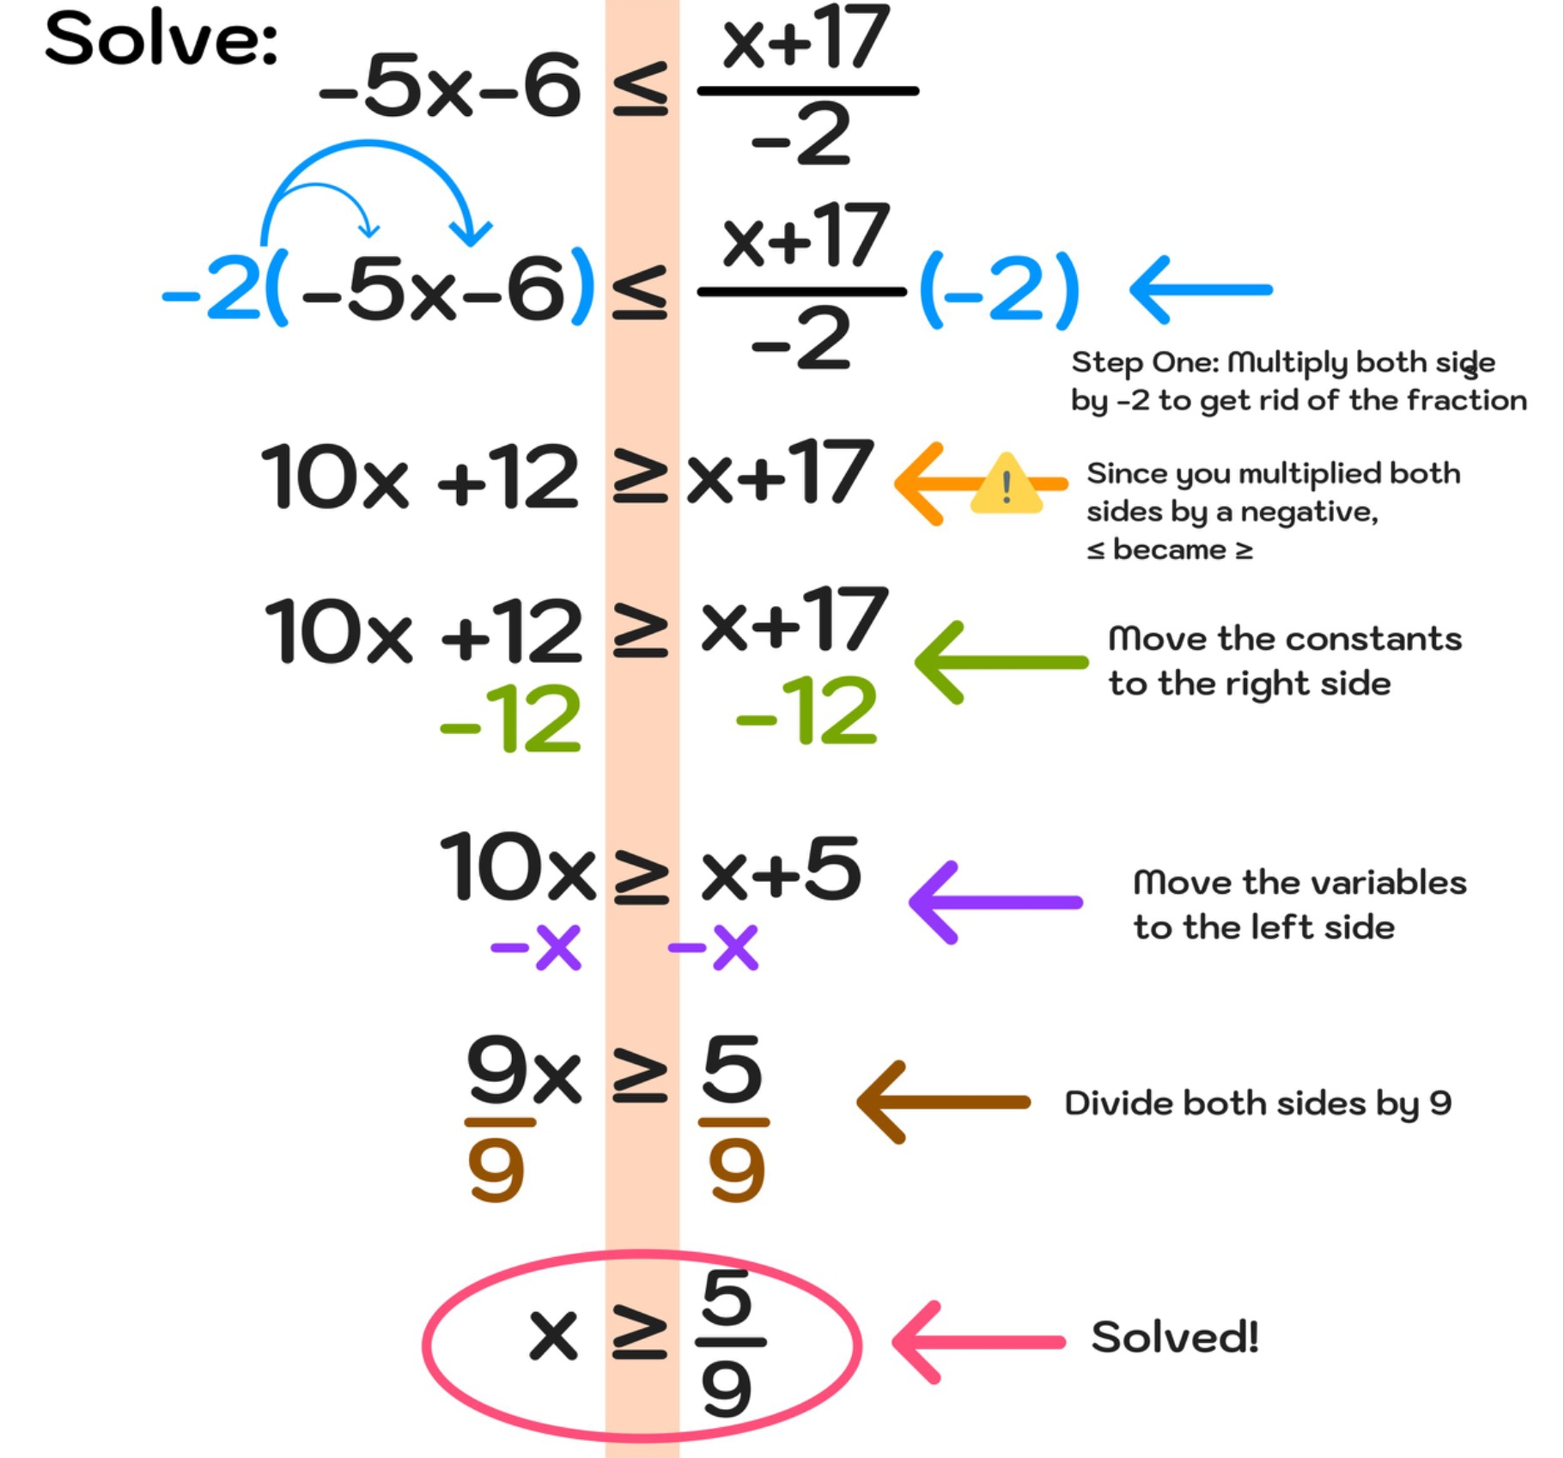
Inequalities: Solving³¹
Solving inequalities is very similar to solving equations.
HOWEVER, if you multiply or divide each side of an inequality by a negative number, you MUST switch the direction of the inequality.
Practice³² for solving inequalities.
Figure 19. Solve an inequality. Adapted from How to Solve Inequalities – Step-by-Step Examples and Tutorial, 2023, retrieved from https://www.mashupmath.com/blog/how-to-solve-inequalities#google_vignette. Copyright 2025 by Mashup Math LLC.

Slide 43
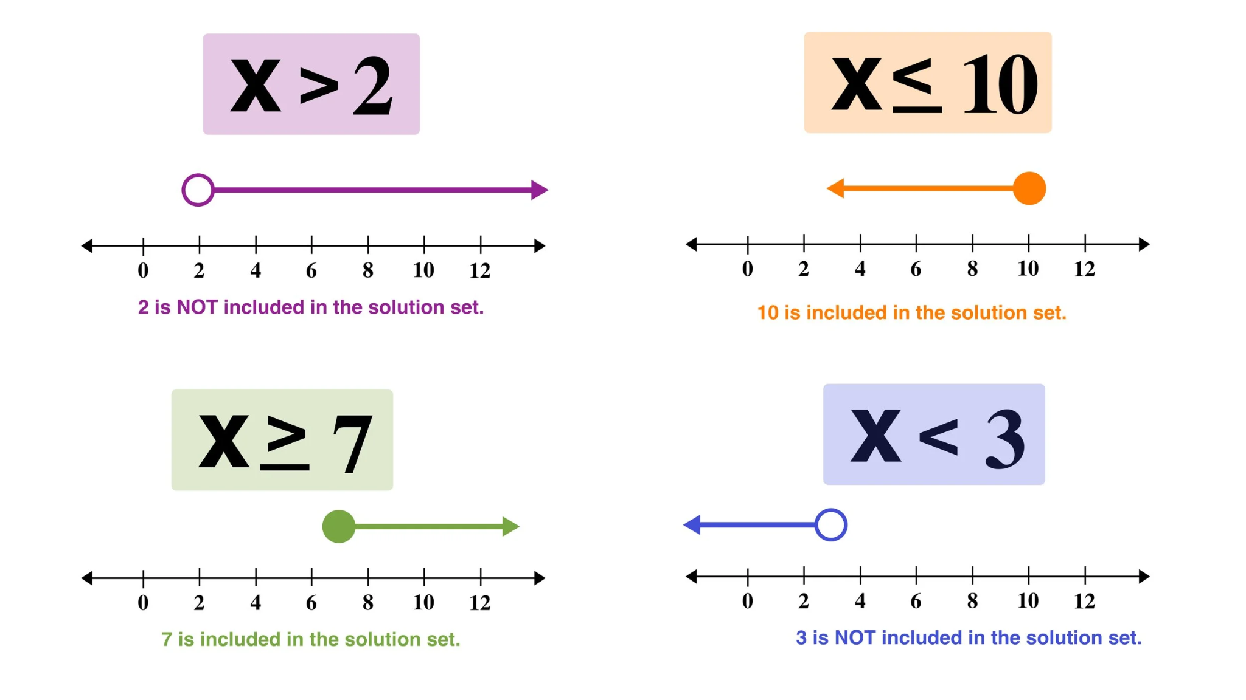
Inequalities: Graphing³³
Look at the graphs to the right. Notice that:
In the graphs for the strict inequalities x > 2 and x < 3, the circles are not filled in; we call these open circles.
In the graphs for x ≤ 10 and
x ≥ 7, the circles are filled in; we call these closed circles.
Practice³⁴ for graphing inequalities.
Figure 20. Graphing inequalities. Adapted from How to Solve Compound Inequalities (in 3 Easy Steps), 2022, retrieved from https://www.mashupmath.com/blog/solving-compound-inequality-graphs-explained. Copyright 2025 by Mashup Math LLC.

Slide 44
Inequalities: Reminder
There is one short section left, and then you are done with this part of the workshop!
If you’d like to return to the Table of Contents slide, click here.

Slide 45
Problem Solving Strategies
If you come across a word problem, don’t panic!
Use a problem solving strategy, like “STAR”:
Search the problem.
Identify the known and unknown quantities in the problem.
Translate into an expression or equation.
Answer the question.
Review your answer.
Does it make sense?
☆ Pro Tip ☆
Use whatever problem solving strategy works best for you. My favorite problem solving strategy is making a list! You can also try working backwards, finding patterns, making a table, or drawing a picture.

Slide 46

Problem Solving Strategies
Jenna’s advice for taking any test:
Don’t panic!
Read carefully.
Watch your signs.
This is kind of specific to math...
Check your answers!
If you’d like to return to the Table of Contents slide, click here.
Figure 21. Expert advice. Adapted from What’s Your Number One Piece of Advice for People with Diabetes? by J. Kwon and K. Close, 2021, retrieved from https://diatribe.org/whats-your-number-one-piece-advice-people-diabetes. Copyright 2025 by the diaTribe Foundation.

Slide 47

THE END!
(of Part 2)
Make sure you check out Part 3: Geometry & Measurement!
Figure 22. Good Luck Captain America GIF. Retrieved from https://tenor.com/view/good-luck-captain-america-salute-gif-12849404.

Slide 48
References Page 1
Math with Mr. J. (2024, February 21). What Are Numerical and Algebraic Expressions? | Algebra | Math with Mr. J [Video]. YouTube. https://www.youtube.com/watch?v=94CH4wB1iDc
MooMooMath and Science. (2021, September 17). Combining Like Terms Algebra [Video]. YouTube. https://www.youtube.com/watch?v=55ReuTDfPKE
Simplifying expressions. (2025). K5 Learning. https://www.k5learning.com/worksheets/math/algebra/grade-5-simplifying-expressions-combining-like-terms-a.pdf
Math Antics. (2016, April 29). Algebra Basics: The Distributive Property - Math Antics [Video]. YouTube. https://www.youtube.com/watch?v=v-6MShC82ow
Distributive Property (A). (2025). Math-Drills.com. https://math-drills.com/algebra/algebra_distributive_2terms_no_exponents_001.1415574873.pdf
Math with Mr. J. (2023, February 21). Simplifying Algebraic Expressions | Distributive Property & Combining Like Terms | Math with Mr. J [Video]. YouTube. https://www.youtube.com/watch?v=1MmhAq-XVN0
Simplifying Expressions (A). (2025). Math-Drills.com. https://math-drills.com/algebra/algebra_expressions_simplifying_as_2v_6t_001.1360936722.pdf

Slide 49
References Page 2
Math with Mr. J. (2022, October 12). Intro to Evaluating Algebraic Expressions | How to Evaluate Algebraic Expressions | Math with Mr. J [Video]. YouTube. https://www.youtube.com/watch?v=k-KiWkV81fQ
Evaluate Expressions. (2025). Super Teacher Worksheets. https://www.superteacherworksheets.com/expressions-evaluate/evaluate-expressions-basic_EVBSC.pdf
MooMooMath and Science. (2021, September 26). Adding and Subtracting Expressions-Algebra-Math [Video]. YouTube. https://www.youtube.com/watch?v=l69_GdggfCo
Adding and Subtracting Linear Expressions (A). (2025). Math-Drills.com. https://math-drills.com/algebra/algebra_linear_addsub_nomultiplier_001.1425581322.pdf
Nerdstudy. (2017, February 11). How to Multiply Polynomials Properly - Nerdstudy [Video]. YouTube. https://www.youtube.com/watch?v=oemqCExRIC0
Multiplying Monomials and Polynomials (A). (2025). Math-Drills.com. https://math-drills.com/algebra/polynomials_multiplying_mixed_mixed_nothirdfactor_001.1675735222.pdf
Bro and Sis Math Club. (2015, September 23). Factoring Out a Monomial - Algebra I [Video]. YouTube. https://www.youtube.com/watch?v=05QwPhUjanE

Slide 50
References Page 3
Factoring out the GCF. (2025). MathMonks.com. https://mathmonks.com/wp-content/uploads/2022/02/Factoring-Out-GCF-of-Polynomials-Worksheet.pdf
The Organic Chemistry Tutor. (2016, July 17). Factoring Trinomials the Easy Fast Way [Video]. YouTube. https://www.youtube.com/watch?v=-4jANGlJRSY
The Organic Chemistry Tutor. (2021, February 8). How to Solve Linear Equations In Algebra [Video]. YouTube. https://www.youtube.com/watch?v=7DPWeBszNSM
Math with Mr. J. (2024, February 28). An Intro to Solving Two-Step Equations | Math with Mr. J [Video]. YouTube. https://www.youtube.com/watch?v=0ackz7dJSYY
Math with Mr. J. (2024, March 27). Solving Multi-Step Equations | Math with Mr. J [Video]. YouTube. https://www.youtube.com/watch?v=XCWkBAUiBxM
Basic algebra. (2025). K5 Learning. https://www.k5learning.com/worksheets/math/algebra/grade-5-basic-algebra-e.pdf
Two-Step Equations. (2025). Super Teacher Worksheets. https://www.superteacherworksheets.com/equations/two-step-equations-basic_TSEQB.pdf

Slide 51
References Page 4
Solve Linear Equations. (2025). OnlineMathLearning.com. https://www.interactive.onlinemathlearning.com/share/worksheets/linear-equation-worksheet3.pdf
Khan Academy. (2015, April 21). Introduction to slope | Algebra I | Khan Academy [Video]. YouTube. https://www.youtube.com/watch?v=MeU-KzdCBps
MooMooMath and Science. (2021, February 9). Slope from a Graph [Video]. YouTube. https://www.youtube.com/watch?v=QaU2opVKZ8U
Linear Equation Graphs (A). (2025). Math-Drills.com. https://math-drills.com/algebra/algebra_find_slope_y-intercept_from_graph_001.1675735220.pdf
The Organic Chemistry Tutor. (2017, April 6). Finding the Slope Given 2 Points - Tons of Examples! [Video]. YouTube. https://www.youtube.com/watch?v=Id_UqMLAXzY
Slope Formula Worksheets. (2025). OnlineMathLearning.com. https://www.interactive.onlinemathlearning.com/share/worksheets/slope-formula-worksheet.pdf
“Intro to slope-intercept form” (video). Khan Academy. Accessed July 7, 2025. https://www.khanacademy.org/math/cc-eighth-grade-math/cc-8th-linear-equations-functions/intro-slope-intercept-form/v/slope-intercept-form

Slide 52
References Page 5
GoTutorMath. (2024, October 13). Graphing Linear Equations using Slope and Y-intercept [Video]. YouTube. https://www.youtube.com/watch?v=TGGSvM20gHo
Graphing Linear Equations (A). (2025). Math-Drills.com https://math-drills.com/algebra/algebra_graph_linear_slope_intercept_001.1675735220.pdf
The Organic Chemistry Tutor. (2017, October 8). How To Solve Linear Inequalities, Basic Introduction, Algebra [Video]. YouTube. https://www.youtube.com/watch?v=DrZJKdXlZ3I
Solving Linear Inequalities (A). (2025). Math-Drills.com. https://math-drills.com/algebra/linear_inequality_div2_mult2_add1_side3_ndswitch2_varswitch3_001.1435603648.pdf
Math with Mr. J. (2021, February 9). Graphing Inequalities on Number Lines | Math with Mr. J [Video]. YouTube. https://www.youtube.com/watch?v=n02r9ZKAi0I
Inequalities on a Number Line 1. (2025). Math Salamanders Limited. https://math-salamanders.s3.us-west-1.amazonaws.com/Inequalities/Inequalities-on-a-Number-Line/inequalities-on-a-number-line-1.pdf

