Slide 1
TEAS Math Workshop
Part 3: Geometry & Measurement

Slide 2
Some introductory notes
The introductory slides are the same for all parts of the workshop.
This workshop is designed to be a comprehensive review of basic math skills and topics that may appear on the TEAS test.
There may be some topics in here that are not covered on the TEAS, and there may be some topics that appear on the TEAS that I did not cover in this workshop. I have never taken the TEAS, but I took some online practice tests and consulted a TEAS prep book for practice and inspiration.
I did my best. If you find any inaccuracies in or have any questions about the workshop, please feel free to email me at jcarter@goodwin.edu.

Slide 3
Some introductory notes
The introductory slides are the same for all parts of the workshop.
In 2020, a colleague and I recorded videos that accompanied this workshop, but they were recorded before the University switched to Canvas. After that switch, the videos were lost.
I have inserted links to videos, websites, and PDFs with practice problems in many of the following slides to make up for the missing videos. The citations for all of these resources are located at the end of this slideshow.
Note:
I am in no way affiliated with the YouTubers or any websites I link in the slideshow. I chose these creators because I like the way they explain math concepts, and I chose the websites because they have a lot of examples (and most have answer keys so you can check your answers).

Slide 4
Some introductory notes
The introductory slides are the same for all parts of the workshop.
If you prefer to work with a tutor or if you want to review a math topic in more depth after completing the workshop, feel free to schedule an appointment with a math tutor! Please come prepared to the appointment with examples to review.
There are also English and science tutors available if you would like to review those subjects. You do not need to be currently enrolled in a math, English, or science course to sign up for TEAS tutoring; you just need to be a current Goodwin student.
Appointments can be on-ground or virtual, but please ensure you read each tutor’s availability carefully so you know if they are on-ground or virtual.

Slide 5
Some introductory notes
The introductory slides are the same for all parts of the workshop.
I know that was a ton of information, and I’m sorry. I just want you to feel as prepared as possible. Some of the videos I linked are pretty long; please don’t feel obligated to watch the whole thing if you don’t need to! I hope you find this workshop helpful.
There is a lot of math to review in here. Remember to take breaks! (I remind you of that a few times throughout the slideshows.)
Now let’s get to the math!
Jenna Carter, Professional Math Tutor

Slide 6

How I’m sure many of you feel
The introductory slides are the same for all parts of the workshop.
But please remember: your mindset can have a HUGE effect on your performance.
Think positively!
For example, instead of thinking, “This is too hard!” think, “With more practice, I will improve!”
[jason701802]. (2010, Aug 19). I'm afraid we need to use...MATH [Video]. YouTube. https://www.youtube.com/watch?v=gENVB6tjq_M

Slide 7
Geometry & Measurement
Table of Contents
Units of Measurement
Conversions
Roman Numerals
Geometric Figures
Two-dimensional figures (2D)
Three-dimensional figures (3D)
Data Presentation
Probability
Statistics
This is the last part that I planned, and I got a little silly. There’s still plenty of great information in here though!
Any text in this slideshow in the pink color shown in the box to the right are links to other slides in this presentation.

Slide 8
Units of Measurement: Imperial
The most commonly used system of measurement in the world is the metric system.
The U.S. and, like, two other countries use these units to measure stuff.
Dimension | Imperial
length | inch, foot, yard, mile
mass | ounce, pound, ton
volume | cup, pint, quart, gallon
temperature | Fahrenheit

Slide 9
Units of Measurement: Metric
The metric system is based on the number 10. The base units of the metric system are: meters (m) for length, grams (g) for mass, and liters (L) for volume.
Note:
The prefixes in the red box are most common. You can remember their order by recalling that King Henry Died By Drinking Chocolate Milk.
Prefix | tera | giga | mega | kilo | hecto | deca | base | deci | centi | milli | micro | nano | pico
Symbol | T | G | M | k | h | da | -- | d | c | m | μ | n | p
Multiplication factor | 10¹² | 10⁹ | 10⁶ | 10³ | 10² | 10¹ | 10⁰ | 10⁻¹ | 10⁻² | 10⁻³ | 10⁻⁶ | 10⁻⁹ | 10⁻¹²

Slide 10
Conversions: A quick note...
If you want to use dimensional analysis (we’ll get to that soon) for metric conversions, that’s totally fine. However, if you want another (possibly easier) method, try this:
If you are converting 34cm to km, think of the order of metric prefixes¹. To get from centi to kilo, you move to the left 5 times. So move the decimal point to the left 5 times.
34cm = 0.00034km
Prefix | tera | giga | mega | kilo | hecto | deca | base | deci | centi | milli | micro | nano | pico
Symbol | T | G | M | k | h | da | -- | d | c | m | μ | n | p
Multiplication factor | 10¹² | 10⁹ | 10⁶ | 10³ | 10² | 10¹ | 10⁰ | 10⁻¹ | 10⁻² | 10⁻³ | 10⁻⁶ | 10⁻⁹ | 10⁻¹²

Slide 11
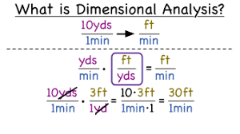
Conversions²
Any text in that reddish color will take you to videos, sites, or PDFs that will help you as you review!
In order to convert one unit of measurement to another, we multiply by a conversion factor.
Conversion factor: a fraction used to convert a value with a unit into another unit
The conversion factor equals 1.
We will review using dimensional analysis on the next few slides.
Figure 1. What is Dimensional Analysis? Adapted from What is dimensional, or unit analysis?, retrieved from https://virtualnerd.com/pre-algebra/ratios-proportions/rates-unit-rates/dimensional-analysis/dimensional-unit-analysis-definition.
Anything in this small writing is a citation for a picture. You can click the links, but they may just be the web address of the picture in the slide.

Slide 12
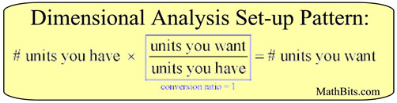
Conversions: Dimensional Analysis
Dimensional analysis: a method of converting measurements by multiplying by conversion factors (or conversion ratios)
In the image above, there is only one conversion factor (or conversion ratio), but you can have multiple conversion factors in dimensional analysis (see next slide).
Figure 2. Dimensional analysis set-up. Adapted from Dimensional Analysis (& Conversion Ratios), retrieved from https://mathbitsnotebook.com/JuniorMath/Measurement/MDimensionalAnalysis.html. Copyright 2025 by MathBitsNotebook.com.

Slide 13

Conversions: Dimensional Analysis
Here is a solved example of converting miles per hours to feet per second.
This is a 3-step conversion because we had to convert miles → feet, then we had to convert hours → minutes → seconds.
Figure 3. Dimensional analysis example. Adapted from Dimensional Analysis (& Conversion Ratios), retrieved from https://mathbitsnotebook.com/JuniorMath/Measurement/MDimensionalAnalysis.html. Copyright 2025 by MathBitsNotebook.com.

Slide 14
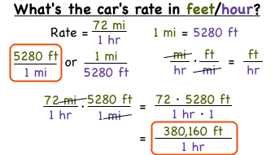
Conversions: Practice
Look for the orange star in the top right corner to quickly identify slides that have links to practice worksheets.
Practice for:
Imperial to imperial³
Metric to metric⁴
Metric and imperial⁵
Dosage calculations⁶ (here’s a review video⁷ for this too)
Figure 4. What’s the car’s rate in feet/hour? Adapted from how do you use dimensional analysis to convert units on one part of a rate?, retrieved from https://psn.virtualnerd.com/viewtutorial/PreAlg_06_01_0006.

Slide 15
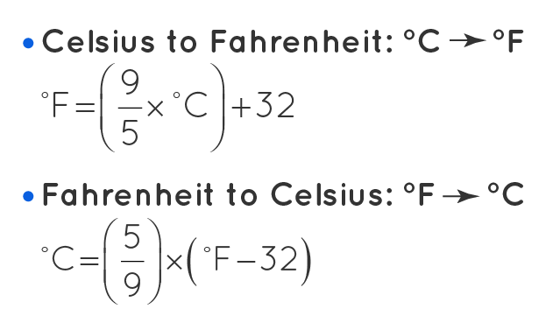
Conversions: Temperature⁸
To convert between degrees Celsius (or Centigrade) and degrees Fahrenheit, use the following formulas:
Practice⁹ for converting temperatures.
Figure 5. Temperature conversion formulas. Adapted from Temperature Converter, retrieved from https://www.cuemath.com/measurement/temperature-converter/.

Slide 16
Conversions: Military Time¹⁰
Military time (or 24-hour time) is based on 24 hours instead of 12 hours. It starts at midnight with 12:00am as 0000, 1:00am as 0100, 2:00am as 0200, and so on until 11:00pm which is 2300.
To convert a civilian time to military time:
From 1:00am-9:59am, add a 0 before the time and remove the colon.
From 10:00am-12:59pm, remove the colon.
From 1:00pm-11:59pm, add 12 to the hours and remove the colon.
From 12:00am-12:59am, replace the 12 with 00 and remove the colon.

Slide 17
**BAD MATH JOKE ALERT**
Q: What do you call numbers that can’t stay still?
A: Roamin’ numerals!
What a great segue...

Slide 18
Roman Numerals¹¹
1 | I
2 | II
3 | III
4 | IV
5 | V
6 | VI
7 | VII
8 | VIII
9 | IX
10 | X
I = 1
V = 5
X = 10
L = 50
C = 100
D = 500
M = 1000
Roman numerals are made of the 7 different symbols listed to the left. As you can see, this numerical system is based on the numbers 1 and 5.
For the most part, Roman numerals are written in descending order (the biggest number to the left, smallest number to the right). Think of them as being added together.
3 = 1 + 1 + 1 = I + I + I = III
7 = 5 + 1 + 1 = V + I + I = VII

Slide 19

Roman Numerals: 4 and 9
I circled 4 and 9 on the previous slide because they are different. I guess somebody (I’ll call them Patrice) decided that writing 4 tally marks was too tedious, so they proposed, “You know what? Since we ADD numbers if they’re in descending order, if we put a lower number first, let’s SUBTRACT it!”
And everyone else was like...
Figure 6. Nobody asked you Patrice! Retrieved from https://giphy.com/gifs/foxhomeent-how-i-met-your-mother-patrice-3o7WIrzMSMQxU6oyYg

Slide 20
Roman Numerals: 4 and 9
But for some reason, they listened to Patrice.
Therefore, if you see a number based on 1 (I = 1, X = 10, or C = 100) before a larger number, you actually subtract it from that larger number.
4 = 5 − 1 = V − I = IV
29 = 10 + 10 + 9 = XXIX

Slide 21

Roman Numerals: Using I, X, and C
Here are the rules for using I, X, and C before other symbols:
You can only use I before V or X to make 4 or 9.
You can only use X before L or C to make 40 or 90.
You can only use C before D or M to make 400 or 900.
For instance: 99 ≠ (100 − 1) = IC
99 = (100−10) + (10 − 1) = XC + IX = XCIX
Practice¹² for writing Roman numerals.
Figure 7. Tony Stark eye roll. Retrieved from https://tenor.com/view/done-fed-up-mad-eyeroll-gif-11969998.

Slide 22
Roman Numerals: Reminder
That’s it for the conversions, military time, and Roman numerals part of the workshop.
If you’d like to return to the Table of Contents slide, click here.

Slide 23
Geometric Figures: Classification
Geometric figures: shapes comprised of points, lines, or planes
Point: a location in space; does not have any dimensional properties like length, area, or volume
I define line and plane on later slides.
One-dimensional figures: objects that can only be measured in one dimension: length
Two-dimensional figures: objects that can be measured in two dimensions: length and width
Three-dimensional figures: objects that can be measured in three dimensions: length, width, and height (or depth)

Slide 24
Geometric Figures: Labels
If you are measuring distance (1 dimension: length), your label will have 1 dimension (ft, cm, mi, m, etc.)
Think of your label like a variable: if there is no exponent, the exponent is 1.
If you are measuring area or surface area (2 dimensions: length×width), your label will have 2 dimensions (ft², cm², mi², m², etc.)
A hint that you are looking for area is the word “square” (how many square feet, how many square centimeters, etc.).
If you are measuring volume (3 dimensions: length×width×height), your label will have 3 dimensions (ft³, cm³, mi³, m³, etc.)
A hint that you are looking for volume is the word “cubic” (how many cubic feet, how many cubic centimeters, etc.).

Slide 25
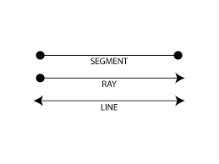
1D Geometric Figures
Line segment: a section of a line with a beginning and end point (has no arrows)
Ray: a collection of points that extends infinitely in one direction (has an arrow on one side)
Line: a collection of points that extends infinitely in both directions (has arrows on both sides)
Perpendicular lines: lines that intersect to form right angles
Parallel lines: line that never intersect
Figure 8. Segment, ray, line. Retrieved from https://theworldmath.weebly.com/lineray-and-segments.html.

Slide 26
2D Geometric Figures
Angle: the space (usually measured in degrees) between two intersecting lines or surfaces at the point where they meet
Polygon: a closed 2D shape with straight sides that do not cross
Regular polygon: a polygon whose side lengths are equal in measure and whose angles are equal in measure
Examples: square, equilateral triangle
The sum of the interior angles of any polygon will be 180(n − 2) where n is the number of sides of the polygon.
Plane: a 2D object that extends infinitely in both directions

Slide 27
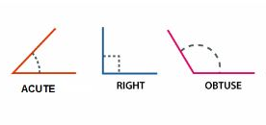
2D Geometric Figures: Angles¹³
Based on their measures, angles fall into different categories:
Acute: an angle which measures between 0° and 90°
Right: an angle which measures exactly 90°
Obtuse: an angle which measures between 90° and 180°
There are a couple more, but you don’t need them for the TEAS.
Note:
If you see a square inside an angle, that means it is a right angle!
Figure 9. Types of angles. Adapted from Angles: An Introduction, retrieved from https://byjus.com/maths/angles/.

Slide 28
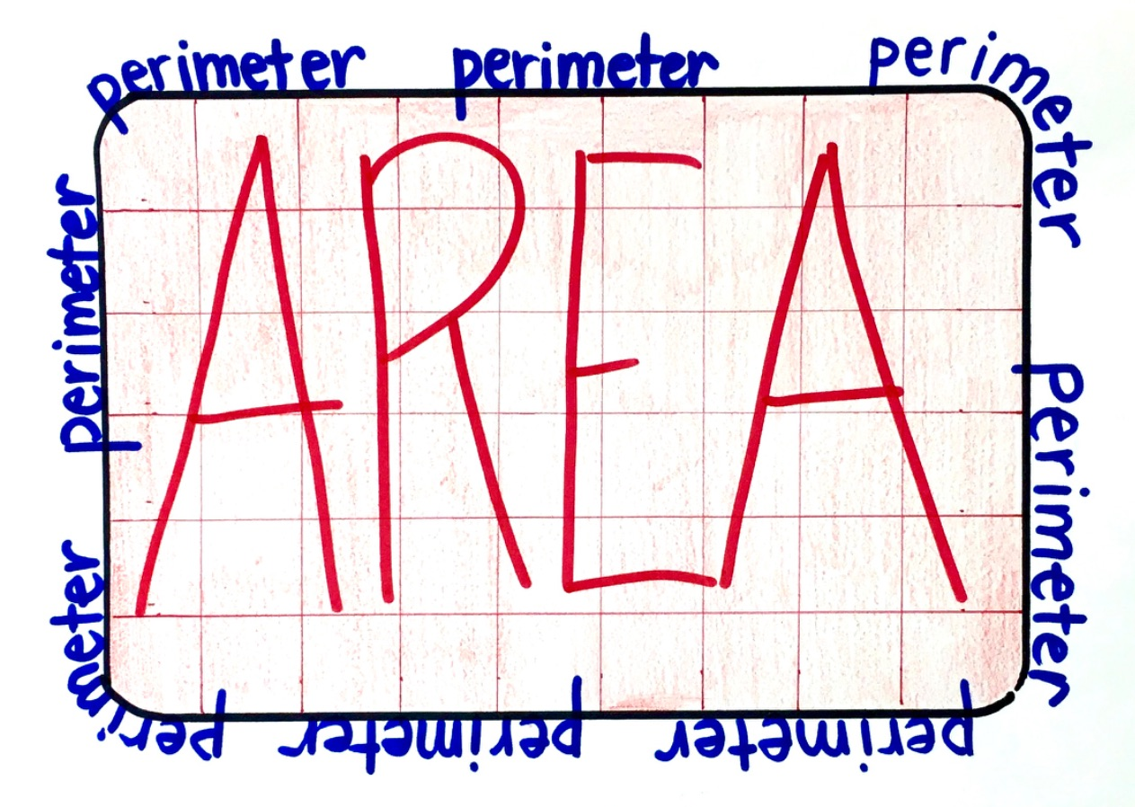
2D Geometric Figures: Measurements
Perimeter: the distance around the figure
The perimeter measures the rim around the figure.
To calculate perimeter of any polygon, just add the measures of all the sides of the polygon.
Area: the space inside the boundaries of a two-dimensional object
Think of “area rugs.”
Different shapes have different formulas for area.
Figure 10. Perimeter and area. Adapted from 3 Tips to Help Students Tell the Difference Between Perimeter and Area, 2023, retrieved from https://beyondtraditionalmath.com/2023/01/28/3-tips-to-help-students-tell-the-difference-between-area-and-perimeter/. Copyright 2026 by Shrub.

Slide 29
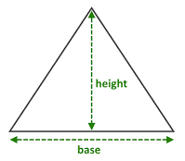
2D Geometric Figures: Triangles
To calculate the area of a triangle¹⁴ (a 3-sided geometric figure), use the following formula:
A = ½bh
where b is the length of the base and h is the height.
Figure 11. Area of a triangle. Adapted from 320. Find the Area of Triangle using base and height, retrieved from https://algorithms.tutorialhorizon.com/find-the-area-of-triangle-using-base-and-height-java-program/.
Note:
The presenter uses a slightly different formula than this, but they both mean the same thing.

Slide 30
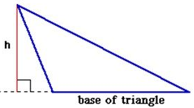
2D Geometric Figures: Triangles
The height of a triangle may actually be outside the triangle, as shown to the right.
A = ½bh
Practice¹⁵ for calculating the area of triangles.
Figure 12. Altitude of an obtuse triangle. Adapted from What is the Altitude of a Triangle?, retrieved from https://byjus.com/maths/altitude-of-a-triangle/.
Note:
The height of a polygon is always perpendicular to (makes a right angle with) the base.

Slide 31
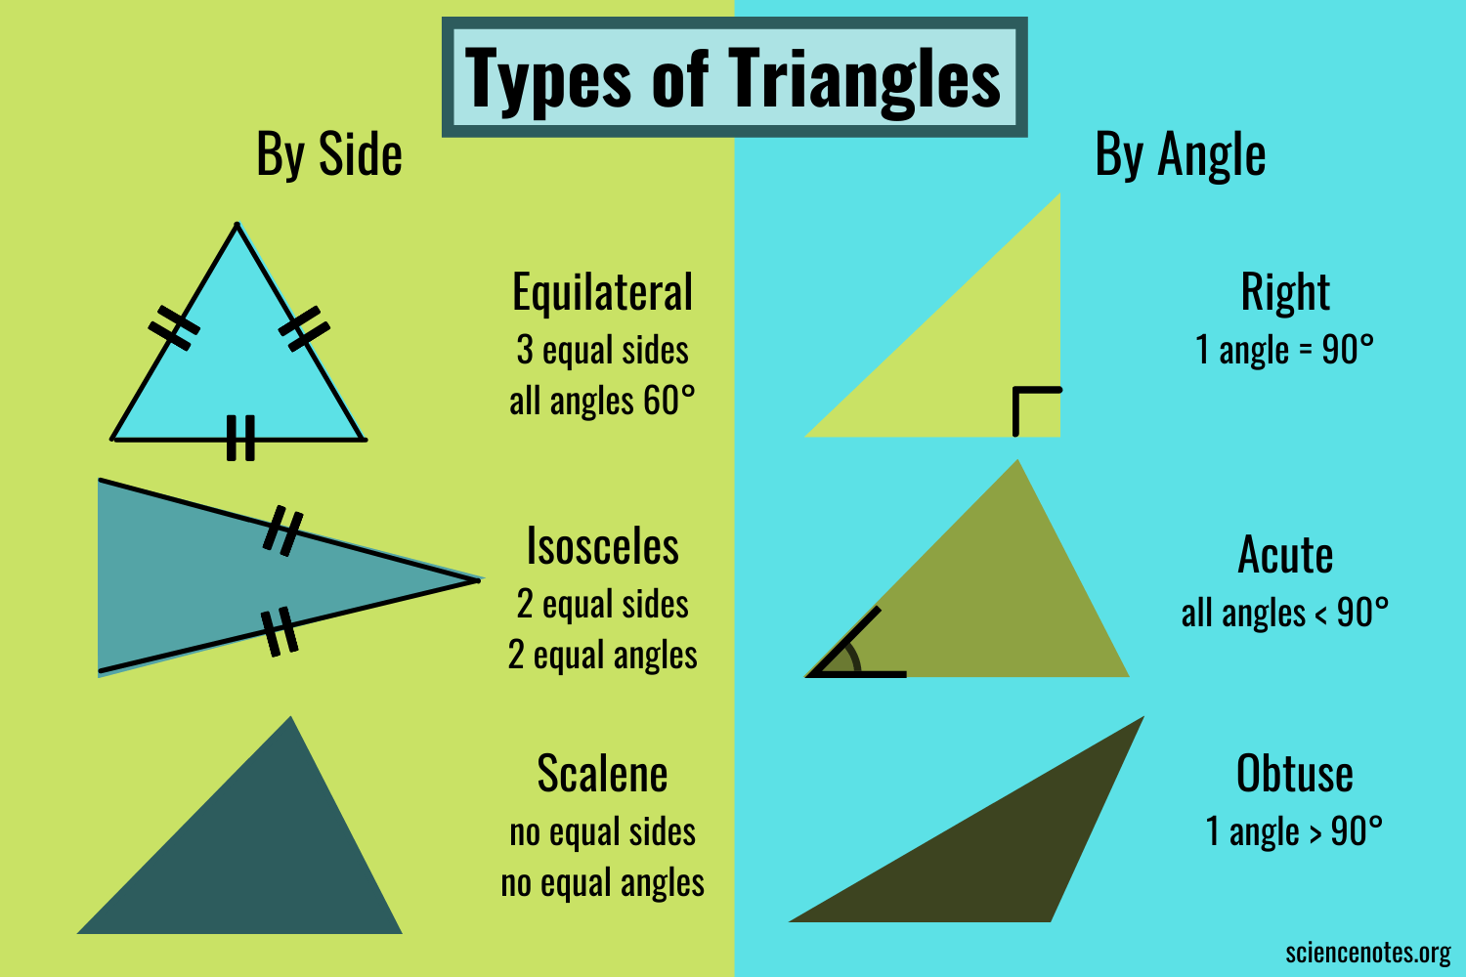
2D Geometric Figures: Triangles
There are two different ways to classify triangles.
Using their sides:
Equilateral: all sides are equal in length
Equilateral triangles are also
equiangular (all angles are the
same measure).
Isosceles: 2 sides are equal in length
Scalene: all 3 sides are different
lengths
Figure 13.
Triangles by
sides. Adapted
from Types of Triangles by Anne Helmenstine, 2022, retrieved from https://byjus.com/maths/altitude-of-a-triangle/. Copyright 2025 by Science Notes and Projects.

Slide 32
2D Geometric Figures: Triangles
There are two different ways to classify triangles.
Using their angles:
Acute triangle: all 3 angles are acute
Right triangle: 1 right angle and 2 acute
angles
Obtuse triangle: 1 obtuse angle and
2 acute angles
Figure 14. Triangles by angles. Adapted from Types of Triangles by Anne Helmenstine, 2022, retrieved from https://byjus.com/maths/altitude-of-a-triangle/. Copyright 2025 by Science Notes and Projects.

Slide 33
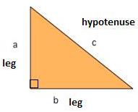
2D Geometric Figures: Right Triangles
Right triangles: triangles that contain a right angle
They are notable because you can use the Pythagorean Theorem¹⁶ to find a missing side length.
Pythagorean Theorem:
a² + b² = c²
where a and b are the lengths of the legs, and c is the length of the hypotenuse (longest side of a right triangle).
Figure 15. Right triangle. Adapted from The Pythagorean Theorem, retrieved from https://www.mathplanet.com/education/pre-algebra/right-triangles-and-algebra/the-pythagorean-theorem.

Slide 34
2D Geometric Figures: Right Triangles
Practice for finding the hypotenuse¹⁷ and finding a missing leg¹⁸ using the Pythagorean Theorem.
Notes:
The Pythagorean Theorem is only for right triangles.
The hypotenuse (c) will always be across from the right angle. (Notice the arrow in the picture to the right.)
It doesn’t matter which leg you label a and b, but the hypotenuse has to be c.
Figure 15. Right triangle. Adapted from The Pythagorean Theorem, retrieved from https://www.mathplanet.com/education/pre-algebra/right-triangles-and-algebra/the-pythagorean-theorem.

Slide 35

2D Geometric Figures: Quadrilaterals
Quadrilateral: a polygon with four sides
Trapezoid: a quadrilateral with only one pair of parallel sides
Parallelogram: a quadrilateral with two pair of parallel sides
Rhombus: a parallelogram with equal side lengths
Rectangle: a parallelogram with equal angle measures
Square: a rectangle with equal side lengths
You can also define a square as a rhombus with equal angle measures.
Figure 16. Some types of quadrilaterals. Adapted from Quadrilateral, retrieved from https://en.wikipedia.org/wiki/Quadrilateral.

Slide 36
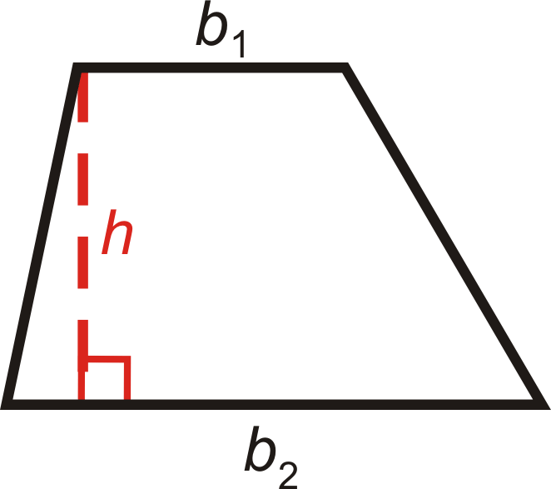
2D Geometric Figures: Trapezoids
To calculate the area of a trapezoid¹⁹, use the
following formula:
A = ½h(b₁ + b₂)
where h is the height, b₁ is one base, and b₂ is the other base.
Note:
The bases are the parallel sides of the trapezoid, but it doesn’t matter which base you label as b₁ and b₂.
Figure 17. Trapezoid. Adapted from Area and Perimeter of Trapezoids, retrieved from https://www.ck12.org/geometry/area-and-perimeter-of-trapezoids/lesson/Area-and-Perimeter-of-Trapezoids-GEOM/. Copyright 2025 by CK-12 Foundation.

Slide 37
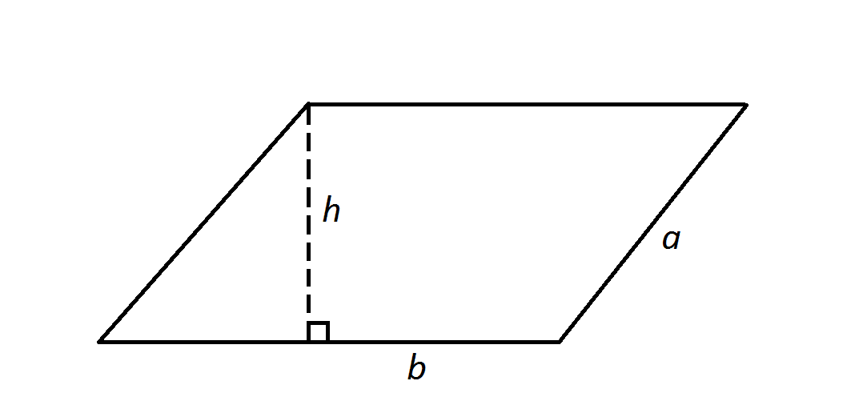
2D Geometric Figures: Parallelograms
To calculate the area of a parallelogram²⁰, use the following formula:
A = bh
where b is the length of the base and h is the height.
Note:
When calculating area, make sure you use the base that is perpendicular to the given height.
Figure 18. Parallelogram. Adapted from SSAT Middle Level Math: How to find the area of a parallelogram, retrieved from https://www.varsitytutors.com/ssat_middle_level_math-help/how-to-find-the-area-of-a-parallelogram. Copyright 2020 by Varsity Tutors.

Slide 38
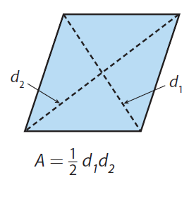
2D Geometric Figures: Rhombuses (Rhombi?)
To calculate the area of a rhombus²¹, use the
following formula:
A = ½d₁d₂
where d₁ and d₂ are the lengths of the diagonals of the rhombus.
Note:
It doesn’t matter which diagonal you label d₁ and which one you label d₂.
Figure 19. Rhombus. Adapted from Finding the Area of a Rhombus, retrieved from https://www.onlinemath4all.com/finding-the-area-of-a-rhombus.html. Copyright onlinemath4all.com.

Slide 39
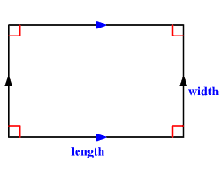
2D Geometric Figures: Rectangles
To calculate the area of a rectangle²², use the following formula:
A = lw
where l is the length and w is the width.
Note:
The longer side is usually called as the length, and the shorter side is usually called the width.
Figure 20. Rectangle. Adapted from Word Problems: Area and Perimeter of a Rectangle, retrieved from https://www.varsitytutors.com/hotmath/hotmath_help/topics/word-problems-area-and-perimeter-of-a-rectangle. Copyright 2020 by Varsity Tutors.

Slide 40
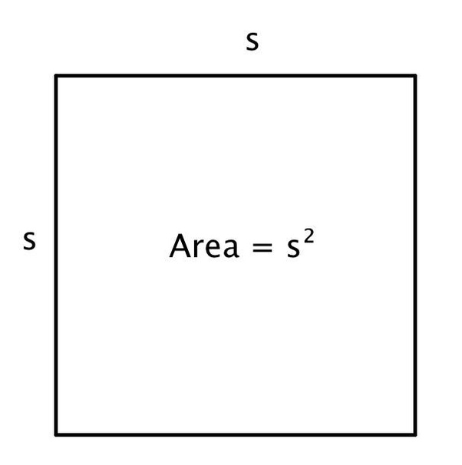
2D Geometric Figures: Squares
To calculate the area of a square²³, just square one of the sides.
A = s²
where s is the length of a side of the square.
Figure 21. Area of a square. Adapted from The area of a square is 36. What is the perimeter?, retrieved from https://www.quora.com/The-area-of-a-square-is-36-What-is-the-perimeter.

Slide 41
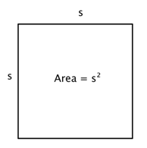
2D Geometric Figures: Areas of Quadrilaterals
Here is a chart of formulas for areas of different quadrilaterals.
Practice²⁴ for finding areas of quadrilaterals (answer key²⁵).
Quadrilateral | Trapezoid | Parallelogram | Rhombus | Rectangle | Square
Picture
Formula for area | A = ½h(b₁ + b₂) | A = bh | A = ½d₁d₂ | A = lw | A = s²
I can’t fit all of the citations for the pictures on this slide, but the slides with citations are linked above the pictures.

Slide 42
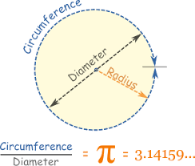
2D Geometric Figures: Circles²⁶
Circles are not polygons because they have curved edges. Don’t worry; we can still find the perimeter (the perimeter of a circle is called the circumference) and area of a circle!
Circumference: C = 2πr
Area: A = πr²
where r is the radius of the circle.
Figure 22. Circumference and diameter. Adapted from Pi (π), retrieved from https://www.mathsisfun.com/numbers/pi.html. Copyright 2024 by Rod Pierce.

Slide 43
2D Geometric Figures: Circles
When calculating the circumferences and areas of circles, you may be told to use 3.14 for π.
Circumference: C = 2πr
Area: A = πr²
Practice²⁷ for finding circumference and area.
Note: r = ½d and d = 2r
Because the radius is half the diameter, you can also use the formula C = πd for circumference. However, the formula with r is more commonly used because the formula for area uses r, too.

Slide 44
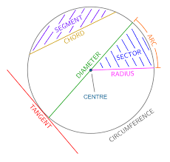
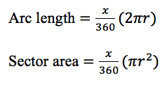
2D Geometric Figures: Circle Features²⁸
Arc: a piece of the circumference of a circle
Sector: a figure formed by two radii and an arc length
where x is the angle measure of the sector and r is the radius of the circle.
Figure 23. Arc length and sector area. Screenshot taken from TEAS Math Materials, Google Doc by Jenna Carter, 2025.
Figure 24. Features of a circle. Adapted from Circles Sectors and arcs Worksheets, Questions, and Revision, retrieved from https://mathsmadeeasy.co.uk/gcse-maths-revision/segment-of-a-circle/.

Slide 45
2D Geometric Figures: Circle Features
Practice²⁹ for finding arc length and sector area (answers on the next slide.)
Note:
There are 360º in a circle. Since you are looking at a fraction of the circumference to find an arc length and a fraction of the area of the circle to find the area of the sector, just create a fraction of given degrees over 360º, and multiply it by the formula for circumference or area!
Figure 23. Arc length and sector area. Screenshot taken from TEAS Math Materials, Google Doc by Jenna Carter, 2025.

Slide 46
2D Geometric Figures: Circle Features
Answers to Arc Length and Sector Area:
Arc length = 56.52 in Sector area = 339.12 in²
Arc length = 19.28 ft Sector area = 163.85 ft²
Arc length = 37.68 yd Sector area = 169.56 yd²
Arc length = 55.82 ft Sector area = 558.22 ft²
Arc length = 3.49 yd Sector area = 8.72 yd²
Arc length = 20.76 in Sector area = 145.31 in²
Arc length = 24.95 in Sector area = 137.2 in²
Arc length = 62.97 ft Sector area = 598.26 ft²
Arc length = 5.23 yd Sector area = 15.7 yd²
Please let me know if I made any mistakes!

Slide 47
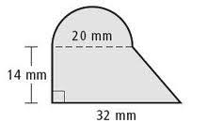
2D Geometric Figures: Composite Figures³⁰
You also might be asked to find the perimeters and areas of composite figures, which are a combination of 2D shapes.
I would find the perimeter and area of this shape by breaking it into two pieces: the semicircle and the trapezoid. Next I would find the perimeter and area of each shape separately, then add them together. I would not add the 20mm distance in the perimeter because it is inside the figure.
Figure 25. Composite figure. Adapted from Composite Figures, retrieved from https://slideplayer.com/slide/10811281/. Copyright 2025 by SlidePlayer.com Inc.

Slide 48
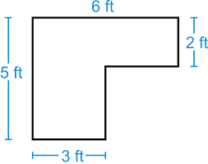
2D Geometric Figures: Composite Figures
To find the perimeter and area of the shape to the right, I could split this shape into two rectangles then find the perimeters and areas of the individual shapes and add them together. However I would not add the orange distance in the perimeter because it is inside the figure.
Practice³¹ for finding perimeter and area of composite figures.
Figure 26. Composite figure with rectangles. Adapted from Area of Composite Shapes, retrieved from https://www.ck12.org/geometry/area-and-perimeter-of-composite-shapes/lesson/Area-of-Composite-Shapes-GEOM/. Copyright 2025 by CK-12 Foundation.

Slide 49
2D Geometric Figures: Reminder
That is the end of 2D geometric figures. I know that was a lot! Remember that you are working towards your goal! Also remember to take breaks when studying.
If you’d like to return to the Table of Contents slide, click here.

Slide 50
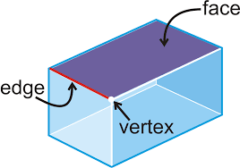
3D Geometric Figures: Vocabulary
Before we review some 3D figures, I am going to define some vocabulary for you.
Vertex: the “corner” of a prism where two or more segments intersect
A vertex will be a point.
The plural of vertex is vertices.
Edge: the line segment where two planes of a 3D shape intersect
Face: the flat surface of a prism
A face will be a 2D figure.
Figure 27. Face, edge, and vertex. Adapted from Polyhedrons, 2020, retrieved from https://www.ck12.org/geometry/solid-figures/lesson/Polyhedrons-BSC-GEOM/. Copyright 2020 by CK-12 Foundation.

Slide 51
3D Geometric Figures: Definitions
Prism³²: a 3D solid whose two end faces are the same, and whose other faces are rectangles
Rectangular prism (or cuboid): a prism whose end faces are rectangles
Cube: a cuboid with all square faces
Triangular prism: a prism whose end faces are triangles
Cylinder: a 3D solid with circular end faces
Sphere: a perfectly round 3D solid
Pyramid: a 3D solid with a polygon as a base and triangular sides that meet at a point
Cone: a 3D solid that tapers smoothly from a circular base to a point

Slide 52
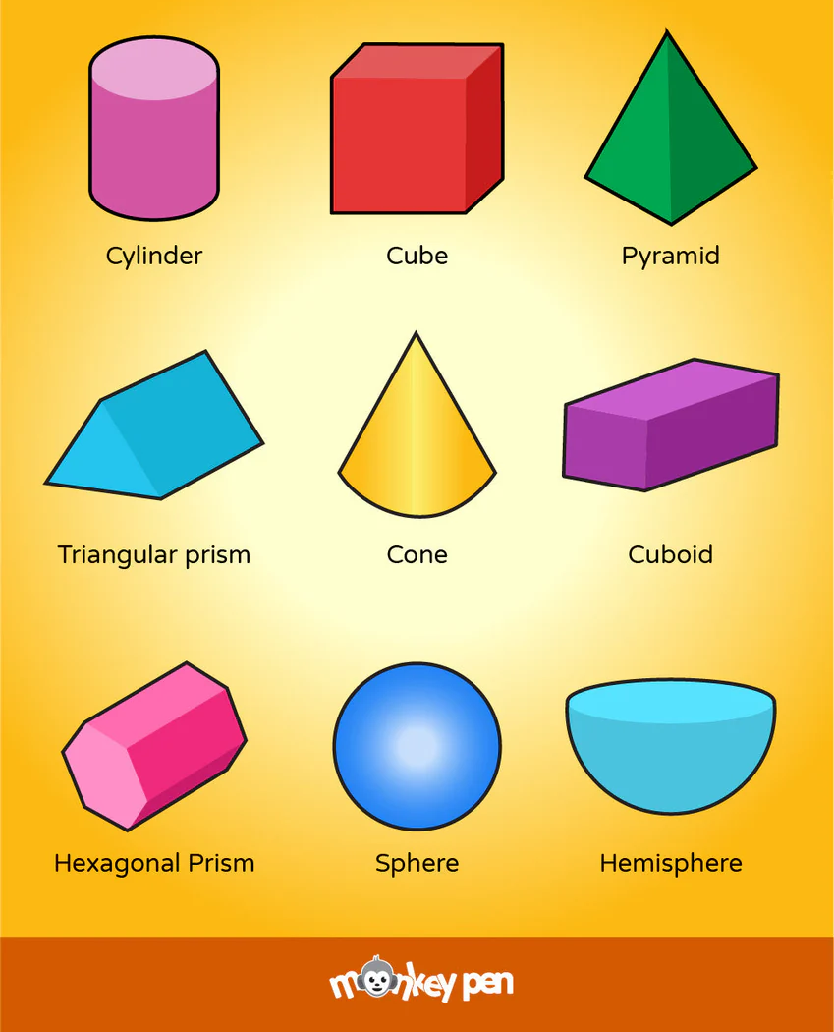
3D Geometric Figures: Measurements
The measurements that are of importance when discussing 3D figures are surface area and volume³³. I will go into more detail about these concepts on the next few slides.
You can see some examples of 3D figures
in the image to the right.
(I don’t think you need to know about
hexagonal prisms or hemispheres.)
Figure 28. 3D shapes. Retrieved from https://monkeypen.com/products/3d-shapes-poster?srsltid=AfmBOoq0QMz2oZ8ByiGpu4KSWNY_GXWEdDmnkXWOSsRCBz2zhy1vGaM7.

Slide 53

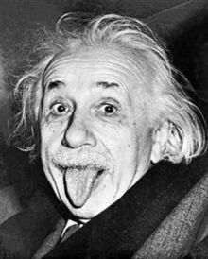

3D Geometric Figures: Surface Area (SA)
Each 3D shape has its own formula for finding its surface area (the total area of the surface of a 3D object). To make it easier on yourself, just find the areas of all the faces and add them together. (I will give you formulas later if you prefer to have them.)
Figure 29. Joker smile embroidery design. Retrieved from https://www.myembdesigns.com/product/joker-smile-embroidery-design/?srsltid=AfmBOooenz18eur6rM_noJe9IkT7vvtjQtPrJXp5_sp5zmlxeeVW9z4k. Copyright by Embroidery Digitizing.
Figure 30. Albert Einstein. Adapted from Albert Einstein: the man who predicted gravitational waves, 2016, retrieved from https://www.bbc.com/news/science-environment-35557727. Copyright 2025 by BBC.
Figure 31. Michelangelo. Retrieved from https://favpng.com/png_view/tmnt-michelangelo-leonardo-raphael-teenage-mutant-ninja-turtles-clip-art-png/PB1Y81pY.

Slide 54
3D Geometric Figures: Volume
Just like how every different 3D shape has its own formula for surface area, they all have their own formulas for volume too. Yay!
I have included formulas for surface area
and volume of 3D solids on the next several
slides. I have split them into categories:
non-tapered solids (they don’t come to a
point; think of cuboids, cubes, cylinders, and
spheres) and tapered solids (they do come to
a point; think of pyramids and cones).
Figure 28. 3D shapes. Retrieved from https://monkeypen.com/products/3d-shapes-poster?srsltid=AfmBOoq0QMz2oZ8ByiGpu4KSWNY_GXWEdDmnkXWOSsRCBz2zhy1vGaM7.

Slide 55
3D Geometric Figures: Non-Tapered Solids
Cuboids³⁴
SA = 2lw + 2lh + 2wh
V = lwh
Cubes
SA = 6a²
V = a³
height
(h)
width
(w)
length
(l)
a

Slide 56
3D Geometric Figures: Non-Tapered Solids
Triangular Prisms³⁵
SA = bh + bl + cl + hl
V = ½bhl
Note:
The bh term in the surface area formula represents the areas of the 2 bases of the triangular prism. The other three terms (bl, cl, and hl) represent the areas of each of the rectangles that make up the remaining faces of the prism.
Another form of this surface area formula is:
SA = bh + l(b + c + h)
side (c)
height (h)
length (l)
base (b)

Slide 57
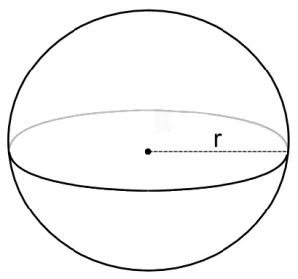
3D Geometric Figures: Non-Tapered Solids
Cylinders³⁶
SA = 2πr² + 2πrh
V = πr²h
Spheres³⁷
SA = 4πr²
V = (4/3)πr³
r
Figure 32. Sphere of radius r. Retrieved from http://www.pitt.edu/~jal283/Assignment13.html.
h

Slide 58
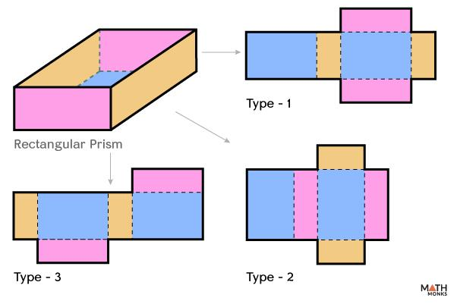
3D Geometric Figures: Non-Tapered Solids
My suggestions for surface areas of non-tapered 3D solids:
Memorize the formulas for surface area of spheres and cylinders.
Memorize the following formulas for areas of 2D shapes:
Triangle: A = ½bh
Rectangle: A = lw
Circle: A = πr²
To find surface area, find the area
of each 2D shape that makes up
the solid and add them together.
Figure 33. Nets of a rectangular prism. Adapted from Rectangular Prism, retrieved from https://mathmonks.com/prism/rectangular-prism. Copyright 2025 by Mathmonks.com.

Slide 59
3D Geometric Figures: Non-Tapered Solids
My suggestions for volumes of non-tapered 3D solids:
Memorize the formula for volume of spheres.
Memorize the following formulas for areas of 2D shapes:
Triangle: A = ½bh
Rectangle: A = lw
Circle: A = πr²
To find the volume, find the area of the base and multiply it by the height.
If you are given a prism with an unfamiliar base and the area of that base, multiply the area by the height.
☆ Pro Tip ☆
For the volume of non-tapered solids,
V = Bh
where B is the area of the base and h is the height of the solid.

Slide 60
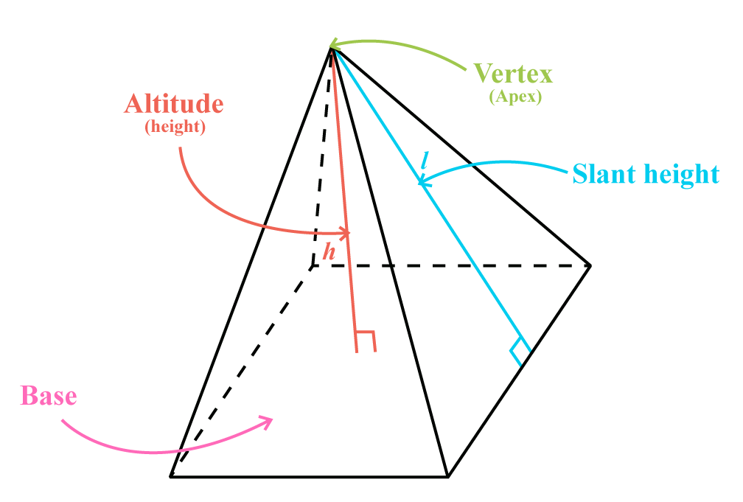
3D Geometric Figures: Tapered Solids
Pyramids³⁸
SA = B + LA
V = ⅓Bh
Note:
Pyramids can have many differently shaped bases; therefore, there isn’t one formula for surface area and volume of pyramids. In the formulas to the left, B is the area of the base, LA is the lateral area (areas of all the triangular sides added together), and h is the height (not the slant height). Please go to Slide 61 for my tips regarding surface area and volume of pyramids.
Figure 34. Parts of a pyramid. Adapted from Volume and Surface Area of a Pyramid, 2020, retrieved from https://calcworkshop.com/volume-surface-area/pyramid/. Copyright 2025 by Calcworkshop LLC.

Slide 61
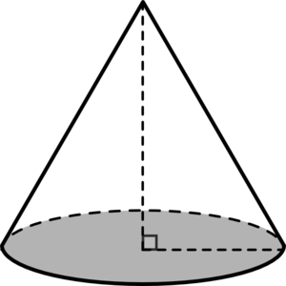
3D Geometric Figures: Tapered Solids
Cones³⁹
SA = πr(r +l)
V = ⅓πr²h
Note:
Compare the formulas for volume of a cylinder (from Slide 57) and volume of a cone.
Cylinder: V = πr²h
Cone: V = ⅓πr²h
The formula for the volume of a cone is the same as the formula for the volume of a cylinder, just multiplied by ⅓!
l
h
Figure 35. Cone clip art. Retrieved from http://www.clker.com/clipart-cone.html.
r

Slide 62
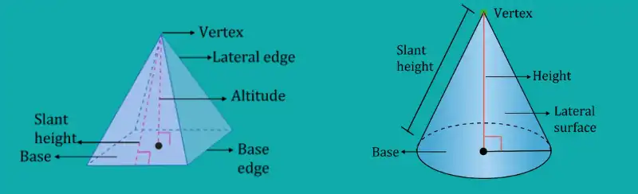
3D Geometric Figures: Tapered Solids
When you are using the formulas for pyramids and cones, be careful about using the height vs. the slant height. They are different!
The height measures the distance from the apex (labeled as vertex in the picture below) through the solid to the middle of the base.
The slant height measures the distance from the apex down a face of the solid to the edge of base.
Figure 36. Pyramids and cones. Adapted from Pyramids and Cones Surface Area, 2022, retrieved from https://www.turito.com/learn/math/pyramids-and-cones-surface-area-grade-9. Copyright 2025 by Turito.

Slide 63
3D Geometric Figures: Tapered Solids
My suggestions for tapered 3D solids:
Memorize the formula for surface area of cones.
Memorize the following formulas for areas of 2D shapes:
Triangle: A = ½bh
Rectangle: A = lw
Circle: A = πr²
To find surface area of a pyramid, find the area of each 2D shape that makes up the pyramid and add them.
To find the volume of either a pyramid or a cone, find the area of the base, then multiply it by ⅓ and the height.
☆ Pro Tip ☆
For the volume of tapered solids,
V = ⅓Bh
where B is the area of the base and h is the height of the solid.

Slide 64
3D Geometric Figures: Surface Area and Volume
Practice for finding surface area⁴⁰ (answers on the next slide) and volume⁴¹ of various 3D solids.

Slide 65
3D Geometric Figures: Surface Area and Volume
Answers to Surface Area:
414.48 ft²
1240 yd²
615.44 in²
502.4 yd²
190 in²
791.28 ft²
322 in²
759.88 ft²
102 yd²
Please let me know if I made any mistakes!

Slide 66
3D Geometric Figures: Reminder
This is the end of the 3D figures part, and actually the entire geometry part. WHEW!
Remember to take breaks while studying.
If you’d like to return to the Table of Contents slide, click here.

Slide 67
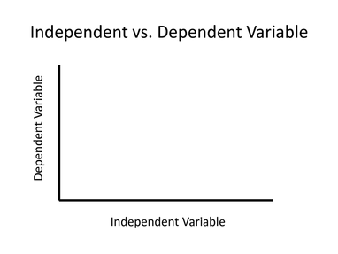
Data Presentation⁴²
Different kinds of plots, graphs, and charts can be used to display data. The type you choose depends on what you want to present about the data.
Graphs must ALWAYS have a title and labels on the axes. Sometimes they also need a legend or a key.
Note:
If time is included, it will almost always be the independent variable.
Figure 37. Independent vs. Dependent Variable. Adapted from Independent vs. Dependent Variable, retrieved from https://www.slideserve.com/karina-morrison/independent-vs-dependent-variable. Copyright 2025 by SlideServe.

Slide 68
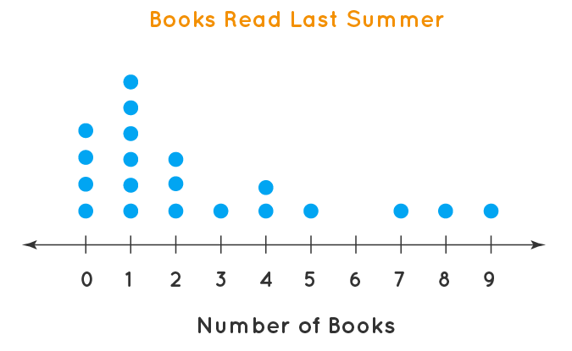
Data Presentation: Dot Plots
Dot plots⁴³ display the frequency of a value or event using dots and can be used to observe the distribution of a data set.
In the dot plot on this slide, you can see that the distribution is skewed right since most of the data is to the left of the number line.
Figure 38. Dot plot example. Accessed from Dot Plot, retrieved from https://www.cuemath.com/data/dot-plot/.

Slide 69
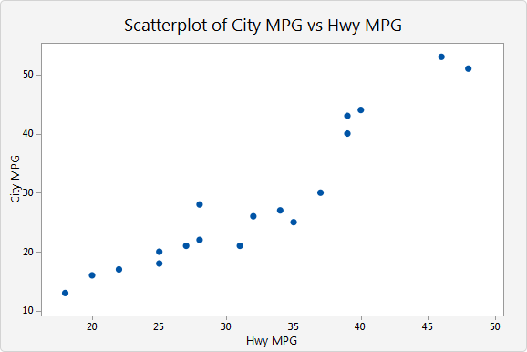
Data Presentation: Scatter Plots
Scatter plots⁴⁴ use points to show relationships between two variables which can be plotted as coordinate points.
DO NOT connect the dots in a scatter plot! If you connect the dots, then you create a line graph (see next slide).
Figure 39. Scatter plot example. Adapted from Overview for Scatterplot, retrieved from https://support.minitab.com/en-us/minitab-express/1/help-and-how-to/graphs/scatterplot/before-you-start/overview/. Copyright 2025 by Minitab, LLC.

Slide 70
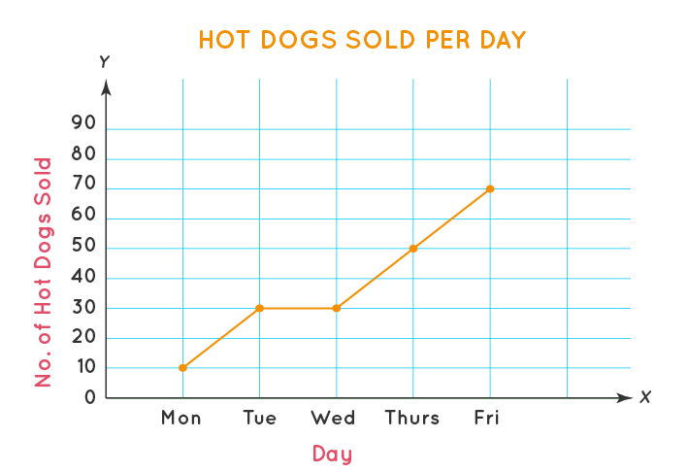
Data Presentation: Line Graphs
Line graphs⁴⁵ show changes in data by connecting points on a scatter plot. Time will frequently be on the x-axis.
This is a single line graph, but you can have a double line graph or a multiple line graph (see next slide).
Figure 40. Single line graph example. Adapted from Line Graph, retrieved from https://www.cuemath.com/data/line-graphs/.

Slide 71
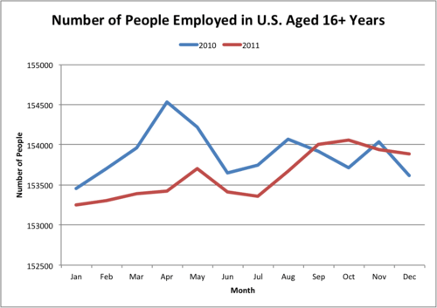
Data Presentation: Line Graphs
You can present more than one set of data on a line graph by using a double line graph or a multiple line graph. These graphs should include a legend or key so readers know what each color means.
(Sorry that this graph isn’t too recent. It’s kind of hard to find correctly labeled graphs on the internet!)
Figure 41. Double line graph example. Adapted from 11.8 Multiple Line Graphs by Erin Marie Smith and Jen Kershaw, 2025, retrieved from https://flexbooks.ck12.org/cbook/ck-12-middle-school-math-concepts-grade-7/section/11.8/primary/lesson/multiple-line-graphs-msm7/. Copyright 2025 by CK-12 Foundation.

Slide 72
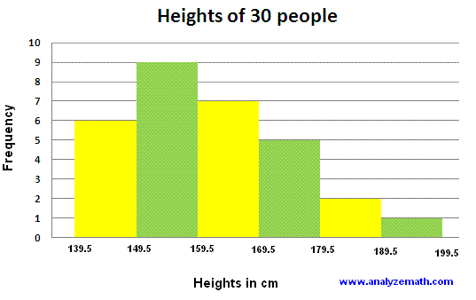
Data Presentation: Histograms
Histograms⁴⁶ use bars to represent data from a frequency distribution. In a histogram, there is NO space between bars.
Histograms are used often in statistics, and they are more complicated than being just bar graphs in which the bars touch. I don’t think you’ll need to know more about them than that for the TEAS, though.
Figure 42. Histogram example. Accessed from Reading Histograms - Examples with Solutions, retrieved from https://www.analyzemath.com/statistics/histogram.html.

Slide 73
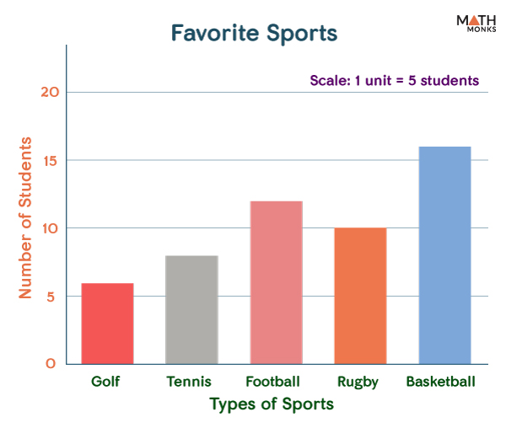
Data Presentation: Bar Graphs
Bar graphs⁴⁷ use bars to show data, but there is a space between bars. They are generally used to display counts of different categories.
This is a single bar graph, but you can have a double bar graph or a multiple bar graph (see next slide).
Figure 43. Single bar graph example. Adapted from Bar Graphs, retrieved from https://mathmonks.com/bar-graphs. Copyright 2025 by Mathmonks.com.

Slide 74
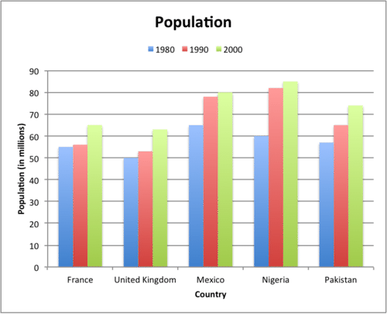
Data Presentation: Bar Graphs
You can present more than one set of data on a bar graph by using a double bar graph or a multiple bar graph. These graphs should include a legend or key so readers know what each color means.
Figure 44. Multiple bar graph example. Adapted from 11.6 Multiple Bar Graphs, retrieved from https://flexbooks.ck12.org/cbook/ck-12-middle-school-math-concepts-grade-7/section/11.6/primary/lesson/multiple-bar-graphs-msm7/. Copyright 2025 by CK-12 Foundation.

Slide 75
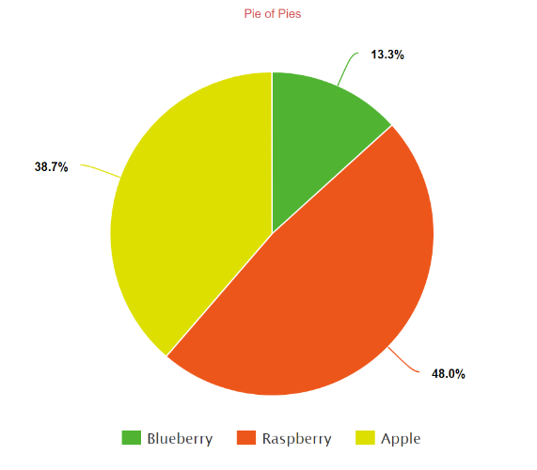
Data Presentation: Circle Graphs
I always called these pie charts⁴⁸. To me, a graph has axes, and a chart doesn’t. *shrug*
Circle graphs *ahem PIE CHARTS* are generally used to display percentages. These charts should include a legend or key so readers know what each color means.
Figure 45. Pie of Pies. Adapted from Create a Pie Chart, retrieved from https://www.meta-chart.com/pie.

Slide 76
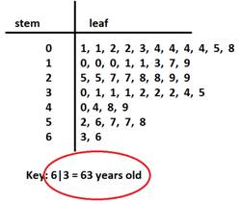
Data Presentation: Stem and Leaf Plots
A stem and leaf plot⁴⁹ takes data entries and splits them into two pieces: the leaf (which is usually the last digit) and the stem (the other digit[s]). These plots should include a legend or key so readers know to read the numbers.
If you wanted to include 103 in the plot to the right, you would use 10 as the stem and 3 as the leaf.
Figure 46. Stem and leaf plot. Adapted from Stem and Leaf Plot, retrieved from https://www.softschools.com/math/topics/stem_and_leaf_plot/. Copyright 2025 by SoftSchools.com.

Slide 77
Data Presentation: Reminder
Sorry there wasn’t any practice in that section. It was a lot of vocabulary.
If you’d like to return to the Table of Contents slide, click here.

Slide 78
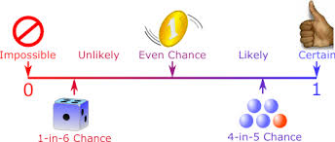
Probability⁵⁰
Trial (or probability experiment): any process that produces a random result
Outcome: the possible individual results of a trial
Sample space (S): the set of all possible outcomes
Event (E): a group or subset of outcomes in the sample space
Probability (P): the likelihood of an event happening
Probability will always be between 0 and 1, inclusive.
Probability can be expressed as a fraction, decimal, or percent.
Figure 47. Probability of events. Adapted from Probability, retrieved from https://www.mathsisfun.com/data/probability.html. Copyright 2023 by Rod Pierce.

Slide 79
Probability: Classical vs. Empirical
Classical probability: when all outcomes are equally likely
Empirical probability: when all outcomes are based on an experiment
P(E) = | number of possible outcomes in the event
 | number of outcomes in the sample space
P(E) = | number of times the event occurs
 | number of times the experiment is performed

Slide 80
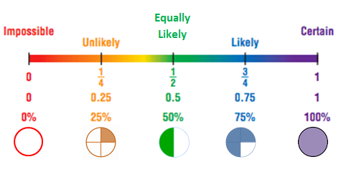
Probability
Practice⁵¹ for calculating probability.
Figure 48. Probability of colors. Adapted from Probability, retrieved from https://www.superteacherworksheets.com/probability/probability10_TZQMZ.pdf. Copyright 2024 by Yvette E. Anthony.

Slide 81
Statistics
Statistics: the study of data
(Yes, I used an entire slide for that.)

Slide 82
Statistics: Measures of Central Tendency⁵²
Mean: the average (add all the data entries and divide by the number of entries)
I had a student remember this by saying it was mean because it made her do the most work.
Median: the data entry that is in the middle when the entries are arranged from least to greatest
If you have two in the middle, take the average!
Think of the median in a highway.
Mode: the number that appears most frequently
There is more on mode on the next slide.
Range: the maximum value minus the minimum value

Slide 83
Statistics: More on Mode⁵³
It is possible to have no mode, one mode, two modes, and even more!
Unimodal: describes a data set with 1 mode
How many wheels does a unicycle have?
Bimodal: describes a data set with 2 modes
How many wheels does a bicycle have?
Multimodal: describes a data set with 3 or more modes
How many wheels does a… wait, that doesn’t work.
Practice⁵⁴ for calculating mean, median, mode, and range.
Note:
Mode is the number that appears most frequently.

Slide 84
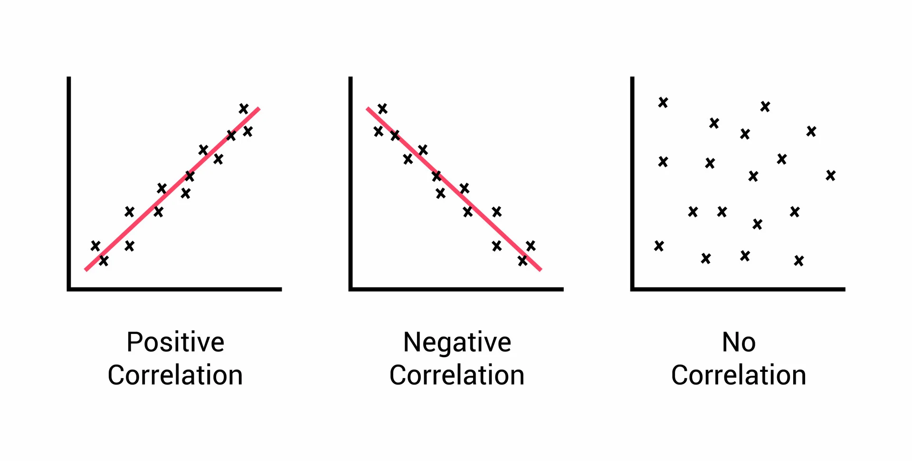
Statistics: Correlation⁵⁵
Correlation: the relationship between two variables, with emphasis on how the variables change together
Data can have a positive correlation, a
negative correlation, or no correlation.
(There are definitions and examples of
each type of correlation on the next slide.)
Figure 49. Correlations in graphs. Adapted from Correlation in Psychology: Meaning, Types, Examples, & Coefficient by Saul McLeod, PhD, 2023, retrieved from https://www.simplypsychology.org/correlation.html.

Slide 85
Statistics: Correlation
Positive correlation: a statistical relationship in which high values of x correspond with high values of y (or low values of x correspond with low values of y)
As x increases, y increases. (Or, as x decreases, y decreases.)
Example: The temperature outside vs. the amount of ice cream sold.
Negative correlation: a statistical relationship in which high values of x correspond with low values of y (or low values of x correspond with high values of y)
As x increases, y decreases. (Or, as x decreases, y increases.)
Example: The amount of miles traveled in a car vs. the gas left in your tank.
No correlation: a statistical relationship in which there is no pattern between x and y
Example: The distance you run vs. the amount of paper you use in your printer.

Slide 86
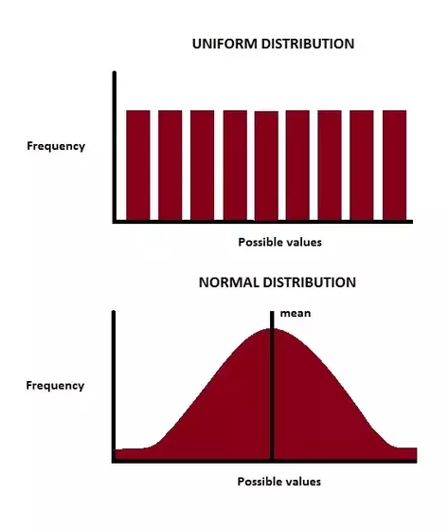
Statistics: Distributions⁵⁶
In statistics, there are symmetric distributions (on this slide) and skewed distributions (on the next slide).
Symmetric distributions: distributions in which the left side mirrors the right side
Uniform (or rectangular): the data are evenly distributed across the graph
Normal: a bell-shaped distribution (“the bell curve”)
Figure 50. Distributions. Adapted from Normal vs. Uniform Distribution by Bikal Basnet, 2017, retrieved from https://www.statisticshowto.com/uniform-distribution/. Copyright 2025 by Data Science & Deep Learning.

Slide 87
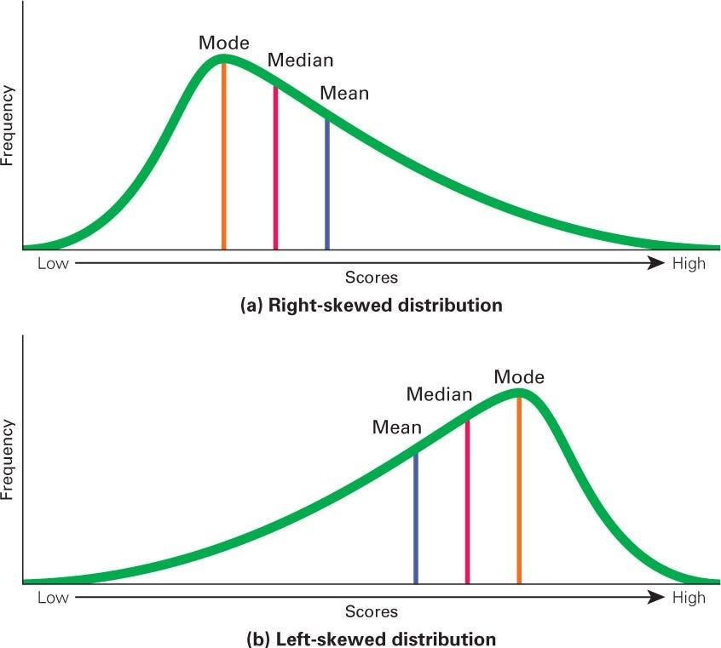
Statistics: Distributions
Skewed distributions: distributions in which more data is concentrated towards one end of the graph
Left-skewed: the mean is skewed to the left of the median and mode
Right-skewed: the mean is skewed to the right of the median and mode
Figures 51 & 52. Skewness. Adapted from What are right-skewed and left-skewed distributions? by R. Gupta, 2022, retrieved from https://medium.com/geekculture/what-are-right-skewed-and-left-skewed-distributions-a29b3def7598.

Slide 88
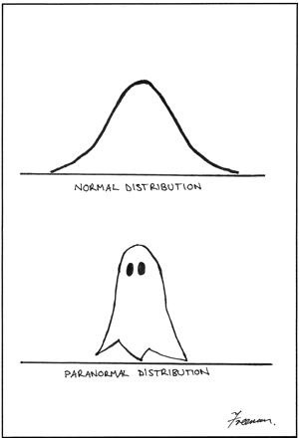
Statistics: Stats Joke
What kind of distribution is this?
What kind of distribution is this?
Figures 53 & 54. Normal vs. Paranormal Distribution. Adapted from A visual comparison of normal and paranormal distributions, retrieved from https://jech.bmj.com/content/60/1/6. Copyright 2025 by BMJ Publishing Group Ltd.

Slide 89
Statistics: Stats Joke
What kind of distribution is this?
What kind of distribution is this?
Figures 53 & 54. Normal vs. Paranormal Distribution. Adapted from A visual comparison of normal and paranormal distributions, retrieved from https://jech.bmj.com/content/60/1/6. Copyright 2025 by BMJ Publishing Group Ltd.

Slide 90
Statistics: Reminder
After enduring that awful math joke, you are now done with the probability and statistics part of this slideshow.
If you’d like to return to the Table of Contents slide, click here.

Slide 91

THE END!
Figure 55. May the odds be ever in your favor. Retrieved from http://forevertwentysomethings.com/2015/01/12/10-thoughts-you-have-going-to-the-gym-by-yourself/may-the-odds-be-ever-in-your-favor/.
Good luck on the TEAS! May the odds be ever in your favor!

Slide 92
References Page 1
Bollendorf Science. (2012, October 3). Metric Conversion Trick!! Part 1 [Video] YouTube. https://www.youtube.com/watch?v=5tHpDzXP-lg
The Organic Chemistry Tutor. (2022, August 31). Dimensional Analysis [Video]. YouTube. https://www.youtube.com/watch?v=vWovdihteqs
Convert between cups, pints, quarts, and gallons. (2025). K5 Learning. https://www.k5learning.com/worksheets/math/grade-5-converting-volume-units-cups-pints-quarts-gallons-a.pdf
Convert metric units of measurement. (2025). K5 Learning. https://www.k5learning.com/worksheets/math/grade-6-conversion-metric-units-mixed-practice-a.pdf
Converting Imperial and Metric Masses (A). (2025). Math-Drills.com. https://math-drills.com/measurement/convert_imperial_metric_mass_all_001.1452699435.pdf
Dosage Calculation Practice. (2025). Scribd Inc. https://www.scribd.com/doc/243824961/Dosage-Practice
RegisteredNurseRN. (2020, November 13). Dosage Calculations Nursing Practice Problems & Comprehensive NCLEX Review [Video]. YouTube. https://www.youtube.com/watch?v=hnzZKY8SGbE
RegisteredNurseRN. (2016, November 11). Celsius to Fahrenheit Formula for NCLEX Exam Quick and Easy [Video]. YouTube. https://www.youtube.com/watch?v=wIPsIgVzLkk

Slide 93
References Page 2
Converting temperatures between Fahrenheit and Celsius. (2025). K5 Learning. https://www.k5learning.com/worksheets/math/grade-4-temperature-converting-fahrenheit-celsius-a.pdf
RegisteredNurseRN. (2021, September 7). Military Time (24-Hour Clock System) Explained for Nurses | New Nurse Tips [Video]. YouTube. https://www.youtube.com/watch?v=6Ti72WkUDU4
The Organic Chemistry Tutor. (2018, May 16). Roman Numerals Explained With Many Examples! [Video]. YouTube. https://www.youtube.com/watch?v=MOIJxae_7Pk
Reading & Writing Roman Numerals (1-50). (2025). Smartmathz. https://www.smartmathz.com/wp-content/uploads/2022/08/grade3_rn1.pdf
Math with Mr. J. (2023, January 27). Types of Angles (Acute, Right, Obtuse, Straight, Reflex) | Math with Mr. J [Video]. YouTube. https://www.youtube.com/watch?v=UsE1hu-q0Cs
Math with Mr. J. (2019, December 15). How to Find the Area of a Triangle | Calculate the Area of a Triangle [Video]. YouTube. https://www.youtube.com/watch?v=pvMuDPVOm7Y
Triangle Area Sheet 1. (2025). Math-Salamanders.com. https://math-salamanders.s3-us-west-1.amazonaws.com/Measurement/Area-of-Right-Triangle/triangle-area-1.pdf
Math with Mr. J. (2023, April 21). An Introduction to the Pythagorean Theorem | Math with Mr. J [Video]. YouTube. https://www.youtube.com/watch?v=nCD-bAEbB3I

Slide 94
References Page 3
Pythagorean Theorem (A). (2025). Math-Drills.com. https://math-drills.com/geometry/pythagorean_theorem_decimal_calculate_hypotenuse_norotation_001.1675735269.pdf
Pythagorean Theorem (A) [1]. (2025. Math-Drills.com. https://math-drills.com/geometry/pythagorean_theorem_decimal_calculate_side_norotation_001.1495551663.pdf
The Organic Chemistry Tutor. (2017, July 26). Area of a Trapezoid [Video]. YouTube. https://www.youtube.com/watch?v=WBgRnFFGCuQ
The Organic Chemistry Tutor. (2017, July 26). Area of a Parallelogram [Video]. YouTube. https://www.youtube.com/watch?v=k7iV42nkXc0
The Organic Chemistry Tutor. (2017, December 30). Area of a Rhombus [Video]. YouTube. https://www.youtube.com/watch?v=3Jx9gGpGbrA
Math with Mr. J. (2023, September 12). How to Find the Area of a Rectangle | Math with Mr. J [Video]. YouTube. https://www.youtube.com/watch?v=vqJmXGIF_1w
Math with Mr. J. (2023, September 15). How to find the Area of a Square | Math with Mr. J [Video]. YouTube. https://www.youtube.com/watch?v=8aYBRmw0VcY

Slide 95
References Page 4
Area of a Quadrilateral. (2025). Tutoringhour.com. https://www.tutoringhour.com/preview/area/quadrilaterals/customary/integers-level1-1.pdf
Area of a Quadrilateral Answer Key. (2025). Tutoringhour.com. https://www.tutoringhour.com/preview/area/quadrilaterals/customary/integers-level1-1-key.pdf
The Organic Chemistry Tutor. (2021, April 2). Circles - Area, Circumference, Radius & Diameter Explained! [Video]. YouTube. https://www.youtube.com/watch?v=D4nGkWOPb6M
Circumference & Area of a Circle. (2025). Mathmonks.com. https://mathmonks.com/wp-content/uploads/2020/12/Circumference-and-Area-of-a-Circle-Worksheet.pdf
your math tutor. (2021, April 20). HOW TO FIND ARC LENGTH AND SECTOR AREA OF CIRCLES | GEOMETRY [Video]. YouTube. https://www.youtube.com/watch?v=z06Hj4vO9FM
Arc Length and Area of a Sector. (2025). Math Worksheets 4 Kids. https://www.mathworksheets4kids.com/circles/arclength-sector/customary/mixed-1.pdf
The Organic Chemistry Tutor. (2024, January 14). How to Find Area of Composite Figures Using Rectangles - Prealgebra [Video]. YouTube. https://www.youtube.com/watch?v=BBzP196v4vM

Slide 96
References Page 5
Areas of Regular Polygons and Composite Area Worksheet. (2025). Mathmonks.com. https://mathmonks.com/wp-content/uploads/2020/07/Areas-of-Regular-Polygons-and-Composite-Figures-Worksheet.pdf
MooMooMath and Science. (2022, June 1). What is a prism? [Video] YouTube. https://www.youtube.com/watch?v=bInSaBRKpfQ
Mario’s Math Tutoring. (2017, May 4). Surface Area and Volume Review (Geometry) [Video]. YouTube. https://www.youtube.com/watch?v=eBAq_caikJ4
Infinity Learn NEET. (2015, May 26). Volume and Surface Area of Cuboids and Cubes (GMAT/GRE/CAT/BankPO/SSC CGL) | Don’t Memorise [Video]. YouTube. https://www.youtube.com/watch?v=PhLc6B5WXtc
The Organic Chemistry Tutor. (2017, July 29). Triangular Prism - Volume, Surface Area, Base and Lateral Area Formula, Basic Geometry [Video]. YouTube. https://www.youtube.com/watch?v=PljECBkHQpg&t=9s
The Organic Chemistry Tutor. (2017, July 28). Volume of a Cylinder and Surface Area of a Cylinder [Video]. YouTube. https://www.youtube.com/watch?v=aEpkAtf2L54
The Organic Chemistry Tutor. (2017, July 28). Volume and Surface Area of a Sphere Formula, Examples, Word Problems, Geometry [Video]. YouTube. https://www.youtube.com/watch?v=EbiwNnyDUoM

Slide 97
References Page 6
Nerdstudy. (2016, November 4). Surface Area and Volume of Pyramids [Video]. YouTube. https://www.youtube.com/watch?v=OY2RRlPPT7A
The Organic Chemistry Tutor. (2017, July 30). Volume and Surface Area of a Cone & Lateral Area Formula- Basic Geometry [Video]. YouTube. https://www.youtube.com/watch?v=JN3LhO0YXw8
Surface Area of Mixed Shapes. (2025). Math Worksheets 4 Kids. https://www.mathworksheets4kids.com/surface-area/mixed-shapes/customary/easy-1.pdf
Volume of Various Shapes. (2023). Clover Digital Brands, LLC. https://k12mathworksheets.com/wp-content/uploads/2024/01/Volume-of-Various-Shapes-1.pdf
Math Antics. (2023, January 17). Math Antics - Data and Graphs [Video]. YouTube. https://www.youtube.com/watch?v=hcgThf5mv38
Math with Mr. J. (2023, October 12). How to Make a Dot Plot | Math with Mr. J [Video]. YouTube. https://www.youtube.com/watch?v=qg8PMqJV3t0
MySecretMathTutor. (2014, February 11). Statistics - Making a scatter plot [Video]. YouTube. https://www.youtube.com/watch?v=NcgRa0uotXs
Khan Academy. (2011, November 14). Reading line graphs | Applying mathematical reasoning | Pre-Algebra | Khan Academy [Video]. YouTube. https://www.youtube.com/watch?v=36v2EXZRzUE

Slide 98
References Page 7
Math Defined. (2023, April 17). Histograms Explained! How to Make a Histogram | Math Defined with Mrs. C [Video]. YouTube. https://www.youtube.com/watch?v=haJyaQObNwU
LearnFree. (2023, February 28). What is a Bar Chart? [Video]. YouTube. https://www.youtube.com/watch?v=WTVdncVCvKo
LearnFree. (2023, February 28). What is a Pie Chart? [Video]. YouTube. https://www.youtube.com/watch?v=GjJdZaQrItg
The Organic Chemistry Tutor. (2019, January 11). Stem and Leaf Plots [Video]. YouTube. https://www.youtube.com/watch?v=MUCvUgGfzdo
Ace Tutors. (2021, January 25). Probability: The Basics EXPLAINED with Examples [Video]. YouTube. https://www.youtube.com/watch?v=YTWM4aOqVwM
Probability. (2025). Super Teacher Worksheets. https://www.superteacherworksheets.com/probability/probability10_TZQMZ.pdf
The Organic Chemistry Tutor. (2017, February 3). Mean, Median, Mode, and Range - How to Find It! [Video]. YouTube. https://www.youtube.com/watch?v=A1mQ9kD-i9I
NNgroup. (2025, May 12). Unimodal vs. Bimodal vs. Multimodal Distributions [Video]. YouTube. https://www.youtube.com/watch?v=HZ6Qpi-R11Y

Slide 99
References Page 8
Mean, Median, Mode, and Range (A). (2025). Math-Drills.com. https://math-drills.com/statistics/mean_median_mode_range_010099range_05inset_001.1675735340.pdf
ProfThacker. (2013, November 22). 02 Positive, Negative, No Correlation [Video]. YouTube. https://www.youtube.com/watch?v=10zppds5Sik
The Organic Chemistry Tutor. (2019, January 25). Skewness - Right, Left & Symmetric Distribution - Mean, Median, & Mode with Boxplots - Statistics [Video]. YouTube. https://www.youtube.com/watch?v=U0NZu6f5TMI

